Slide 1

Pretrial Release and Detention in Connecticut: Ten and Seven Percent Cash Bail

Slide 2
Trends in Pretrial Detention
Total Incarcerated population as of October 1, 2024: 10,819
  Sentenced population: 6,771
  Pretrial population: 3,723
    34% of CT DOC population
Total Incarcerated Population on October 1, 2008: 19,657
  Roughly a 45% reduction in the incarcerated population since 2008
But pretrial population has not decreased at the same rate
  Pretrial population on October 1, 2008: 4,148
  Roughly a 10% decrease in the pretrial population from 2008

Slide 3
Ten and Seven Percent Cash Bail in Connecticut
Prior to 2020: Practice Book Sec. 38-8 Ten Percent Cash Bail (Non-automatic)
When 10 percent cash bail is granted, upon the depositing in cash, by the defendant or any person in his or her behalf other than a paid surety, of 10 percent of the surety bond set, the defendant shall thereupon be admitted to bail in the same manner as a defendant who has executed a bond for the full amount.

Slide 4
Ten and Seven Percent Cash Bail in Connecticut
Practice Book Sec. 38-8. Ten Percent Cash Bail (went into effect on January 1, 2020)
Unless otherwise ordered by the judicial authority, 10 percent cash bail shall be automatically available for surety bonds not exceeding $20,000. For surety bond amounts exceeding $20,000, 10 percent cash bail may be granted pursuant to an order of the judicial authority. This 10 percent option applies to bonds set by court as well as bonds set at the police department.

Slide 5
Ten and Seven Percent Cash Bail in Connecticut
Practice Book Sec. 38-8. Seven Percent Cash Bail (went into effect January 1, 2024)
  Unless otherwise ordered by the judicial authority, 7 percent cash bail shall be automatically available for surety bonds not exceeding $50,000. For surety bond amounts exceeding $50,000, 7 percent cash bail may be granted pursuant to an order of the judicial authority. This 7 percent cash bail option applies to bonds set by the court as well as bonds set at the police department.

Slide 6
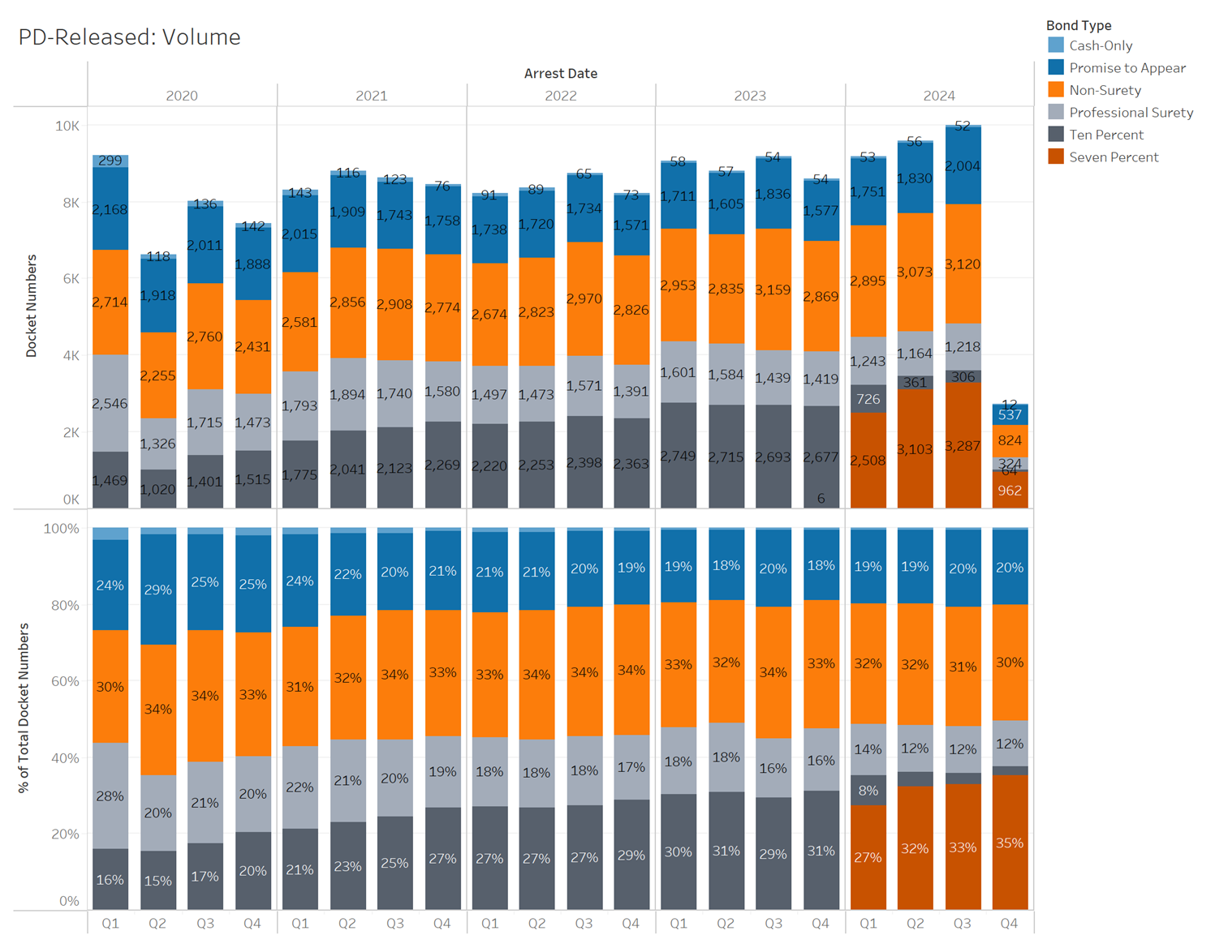
PD-Released: Volume
Once booked at a police station, an initial bond type is set by the arresting agency. Defendants can be released or post bond prior to interview by JB-CSSD Pretrial Services.
Since 2020, the utilization of both ten and seven percent bail has steadily increased, making up around 15%-20% of releases in 2020 to about 33% to 37% of releases in 2024.
The introduction of seven percent bail appears to have increased utilization further. In Q2 and Q3 2024, ten and seven percent bail reached its highest overall utilization rate ever of 37%.
Promise to appear and non-surety release rates have remained relatively constant with larger decreases observed for professional surety release.

Slide 7
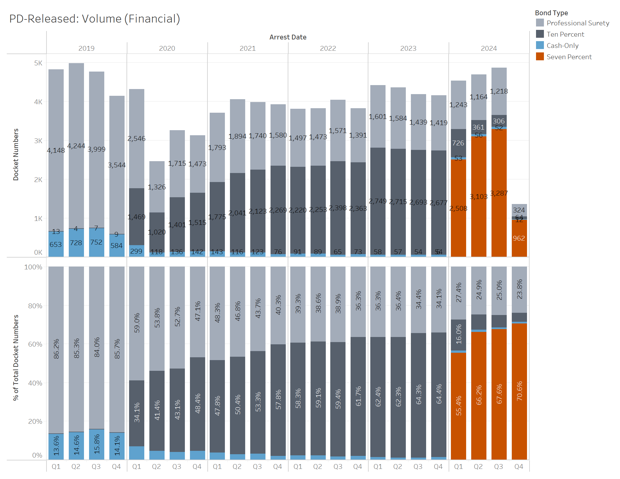
PD Released Volume: Financial Conditions Only
The percent of PD-released defendants who are released under cash-only and professional surety mechanisms has reduced substantially since 2019, decreasing from 100% of financial releases to ~25%.
The percent released under ten and seven percent cash bail reached six-year highs in 2024 with about 71% of PD defendants being released under the mechanisms.
Seven percent bail utilization has steadily increased across all 2024 quarters.

Slide 8
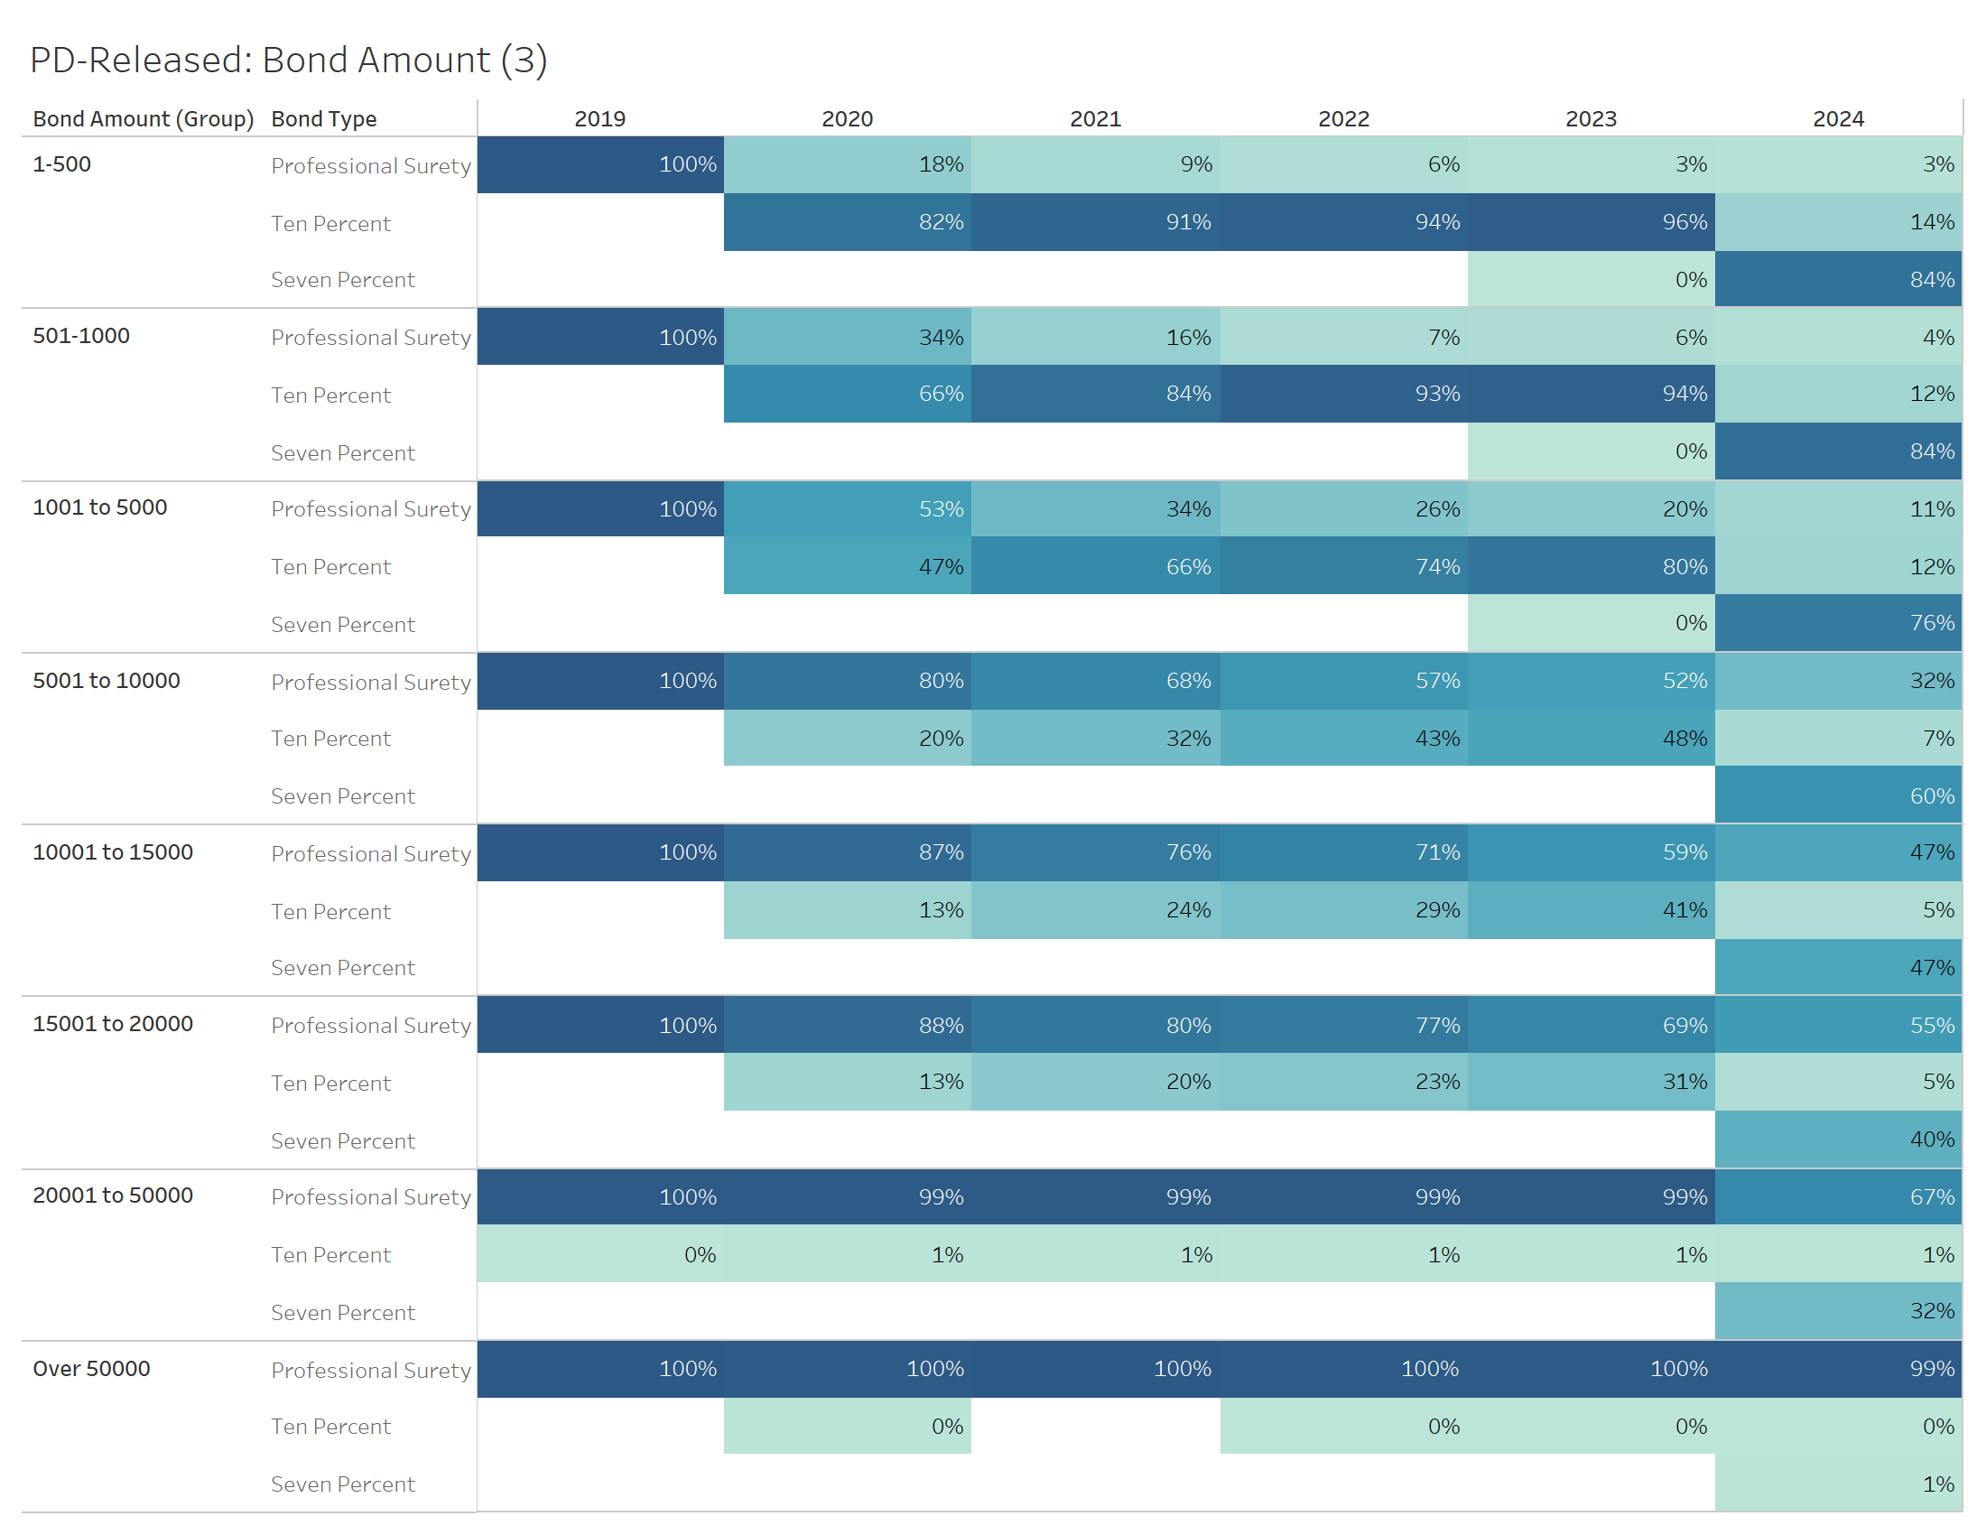
PD Release: Bond Amounts
The utilization of ten and seven percent bail varies from 98% of releases to 33% of releases across all eligible bond amount groups.
Utilization is highest at lower bond amounts
  Ten and seven percent cash bail account for the majority of PD releases for all bond groups less than $15,001.
Following the 2024 expansion of bond eligibility, 33% of PD released defendants with bond amounts between $20,001 and $50,000 utilized ten and seven percent cash bail.

Slide 9
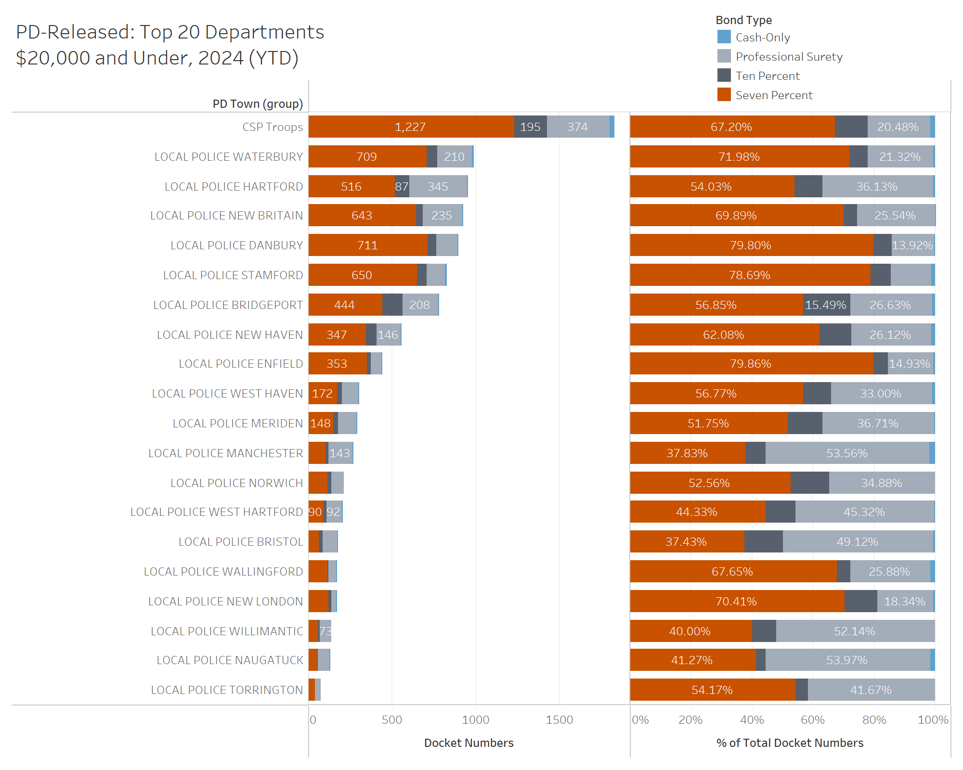
PD Released: Top 20 Departments​
Among the top 20 police departments that released the largest number of defendants in 2024, there is wide variation in ten and seven percent cash bail utilization rate, ranging from ~85% to ~37 percent.

Slide 10
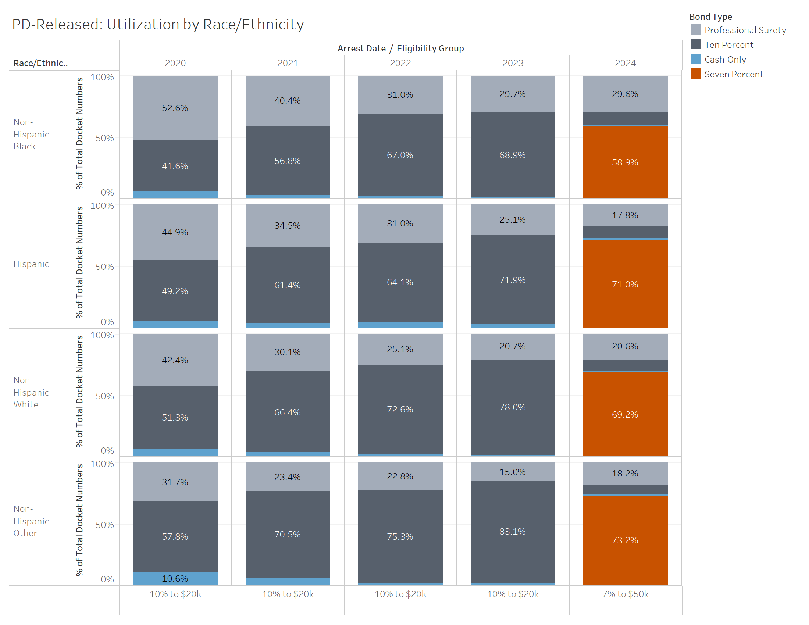
Utilization by Race/Ethnicity
Use of ten and seven percent bond has steadily increased across all racial/ethnic groups since implementation.
Among financial bonds posted at police departments during the first 10 months of 2024, the proportion of each demographic group that utilized the ten percent or seven percent option are as follows:
  Hispanic: ~82%
  Non-Hispanic Black: ~69%
  Non-Hispanic White: ~79%
Notes:
Non-Hispanic black utilization rate is the least

Slide 11
PD Released Outcomes: New Criminal Arrests During Pendency
New arrest rates have been steadily decreasing since 2020 across all bond types.
In 2023, the new arrest rate for PD released defendants who used seven and ten percent bail was around 15%, lower than all other bond types except cash only (*Number of Cash-Only Cases: 178, Ten Percent Cases: 8,669).
The majority of PD released defendants are not rearrested during the pretrial period.
Bond Type | 2020 | 2021 | 2022 | 2023 | 2024
Promise to Appear | 38.40% | 31.60% | 26.08% | 21.72% | 11.37%
Non-Surety | 35.57% | 28.00% | 25.04% | 20.70% | 11.76%
Ten Percent | 28.40% | 24.25% | 20.74% | 15.46% | 8.25%
Professional Surety | 37.60% | 36.04% | 32.74% | 24.86% | 14.19%
Cash-Only | 20.33% | 15.80% | 12.54% | 8.99% | 5.49%
Seven Percent |  |  |  |  | 8.76%

Slide 12
PD Released Outcomes: Failure to Appear Rate During Pendency
Bond Type | 2020 | 2021 | 2022 | 2023 | 2024
Promise to Appear | 14.12% | 15.58% | 14.24% | 11.36% | 5.98%
Non-Surety | 12.05% | 13.60% | 12.23% | 9.76% | 6.04%
Ten Percent | 9.58% | 12.60% | 11.12% | 8.29% | 5.17%
Professional Surety | 13.46% | 16.79% | 16.01% | 14.34% | 6.96%
Cash-Only | 7.59% | 10.16% | 6.44% | 9.55% | 1.10%
Seven Percent |  |  |  |  | 3.65%
Failure to appear rates have largely remained constant from 2020 to 2023 across bond type groups.
Among PD released defendants, defendants who utilized ten percent bond had the second lowest failure to appear rate across 2020 to 2023.
In 2023, 91.71% of those released under ten percent bond successfully appeared in court.

Slide 13
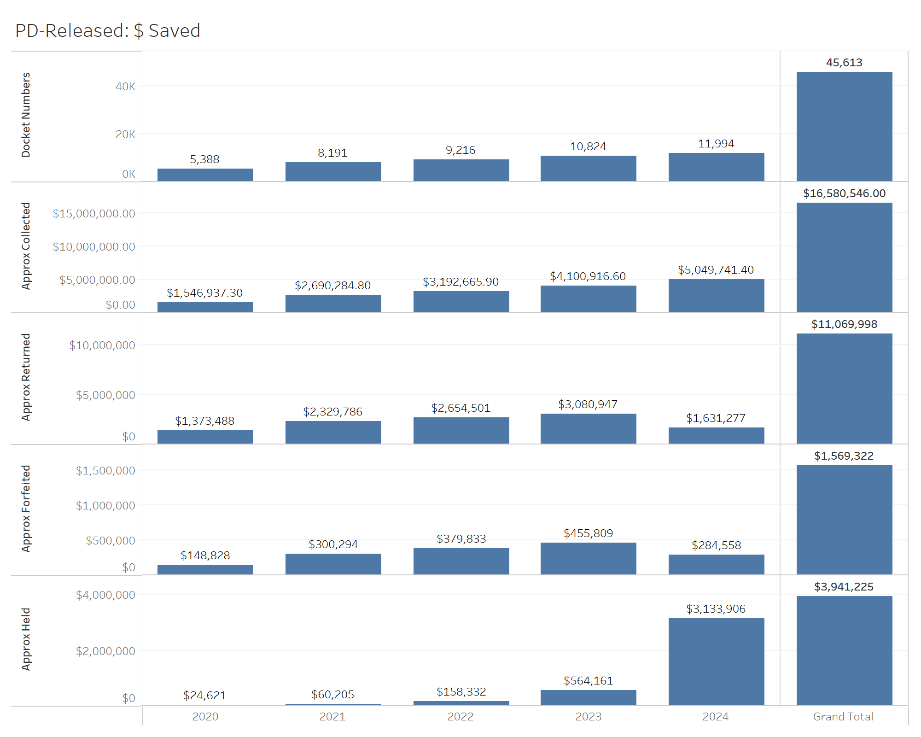
Dollars Saved
Since 2020, over $11 million in bond funds have been returned to defendants due to ten and seven percent cash bail.

Slide 14
Conclusions
In 2024, ten and seven percent cash bail makes up around 30% of police department eligible releases and about 70% of financial conditions releases.
Utilization of ten and seven percent bonds is highest at the lowest bond amounts.
Ten and seven percent bail has not increased in re-arrest or failure to appear rates, with rearrests falling consistently since 2020.
Ten and seven percent bail has saved defendants over $11 million since 2020.

