Slide 1

PRETRIAL Misdemeanor POPULATION REVIEW
Michael Hines, Director of Pretrial Services
December 5, 2025

Slide 2

Data reviewed As of 10.16.2025
Total Clients held in DOC: 383
Clients with additional felony charge picked up after DOC Admission
Family Violence (FV) Clients
Clients held on Detainer
Clients not interviewed by Pretrial:
Clients held on misdemeanor charges:
111
40
29
42
161

Slide 3
Risk Score Range based on bir (assessment data)
Review of 144 clients with
DOC admit date 03/10/2023 - 10/14/2025
Risk Scores of +6 – -21 (least to highest risk)
Six clients fell into the 0 –+6 point range
3 of the 6 clients have been disposed of in court
The average risk score for all clients was: -10.5

Slide 4
CATEGORY OF CLIENTS REVIEWED
Non-Financial Release Recommendations
Multiple Failures to Appear on underlying case
Multiple Cases Pending
Underlying Serious Mental Health
(many indicated homelessness)
Significant Criminal History Including Prior FTA’s

Slide 5

Additional findings
Clients who had out of state residency or no Connecticut ties.
Clients who were non-compliant with court orders of release.

Slide 6
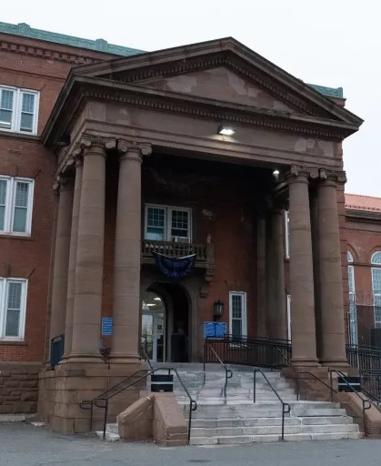
Walker project
Clients informed researchers that they were using pretrial detention as part of their final disposition of their case.
The ability to stay connected to their families was a major contributing factor.

