Slide 1
CST Report- Overview
December 10, 2025
Mental Health and Addiction Services

Slide 2

Competence to stand trial
Dusky v. U.S. (1960):
Sufficient present ability to consult with an attorney with a reasonable degree of rational understanding (“ability to assist”)
AND
Rational as well as factual understanding of the proceedings against him (“rational understanding”)

Slide 3
ORIGINS OF THE REPORT
“The Competency Crisis”
2000: 60,000 CST evaluations/year
2023: at least 130,000 CST evaluation/year
Incompetent findings have increased from 27% to approximately 50% of evaluees
Wait times for inpatient restoration beds are 6-12 months in many states
At least 13 states are facing class-action litigation about CST
Murrie, D. C., et al. (2023). Behavioral Sciences & the Law, 41(5), 310–325.

Slide 4
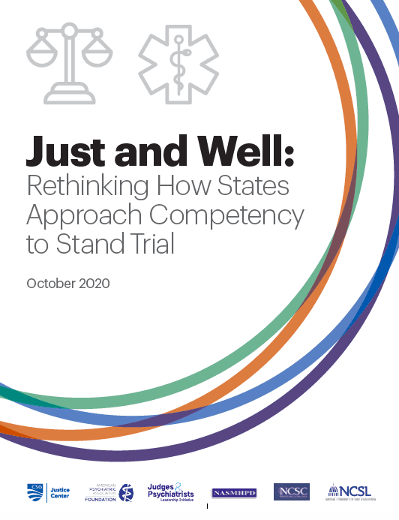
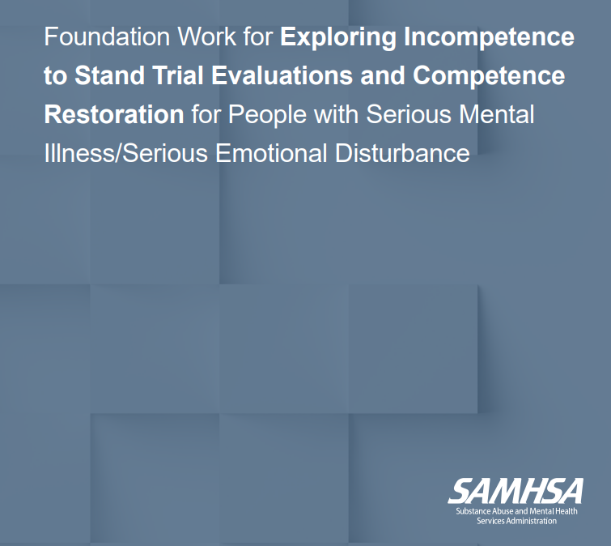

National calls for reform
Notes:
In 2020-2022, three major national reports: National Center for State Courts, SAMHSA, Center for State Governments, National Commission on State Legislatures. Made broad recommendations that are helpful but not necessarily specific to Connecticut.

Slide 5
TIMELINE of the Report
A. Tsarkov asks R. Kapoor to lead report
Commission receives additional funding from legislature to study
mental health
All report revisions completed
May
2023
May
2024
2019
Oct
2022
July
2023
Dec
2025
Sen. Osten requests
study of mental health
and incarceration
Commission trip
to Miami
Passage of PA 24-137
Notes:
Commission produced two previous reports about MH and criminal legal system (prevalence of MI in DOC population), received funding in 2022 to continue studies. Combined with May 2023 trip to Miami-Dade County, formed impetus to focus on competency to stand trial. In July 2023 formed a working group, with initial intent to complete a short report before Feb 2024 legislative session so that stakeholders would understand the context. Ended up not needing the report to get PA 24-137 passed, so continued to work on report, involving DDS, DCF, Judicial, and DMHAS in collecting data and describing processes. Found a lot of data discrepancies, so finally completed in Dec 2025.

Slide 6
Report methodology
Data drawn from multiple sources:
DMHAS:
Office of Forensic Evaluations
Whiting Forensic Hospital
DDS
DCF
Judicial Branch
Data analysis performed by DMHAS. Found several discrepancies, which are identified in report.
Recommendations are from Commission

Slide 7
COMPETENCY TO STAND TRIAL
CONNECTICUT GENERAL STATUTE §54-56d
A defendant shall not be tried, convicted or sentenced while the defendant is not competent. A defendant is not competent if the defendant is unable to understand the proceedings against him or her or to assist in his or her own defense. [C.G.S § 54-56d]
Competency to Stand Trial
Mental Health and Addiction Services

Slide 8
COMPETENCY TO STAND TRIAL
Two Prongs of Competency
1) Capacity to Understand Proceedings
Knowledge of the charges, including the specific allegations and the meaning of the charges
Knowledge of courtroom personnel roles
Knowledge of potential and likely penalties
Knowledge of available defenses/pleas
Appraisal of outcomes of various pleas
Capacity to apply this knowledge (rational understanding)
2) Ability to Assist in Defense
Ability to collaborate with defense counsel
Communicate with counsel in a rational and relevant manner
Ability to seek, comprehend and utilize advisement from attorney
Awareness of their rights to protect themselves
Ability to make decisions based upon facts of the case, such as strength of witnesses/evidence against them, as well as consideration of their attorney’s advisements
Competency to Stand Trial
Mental Health and Addiction Services

Slide 9
Competency Evaluations
Who:
DMHAS Office of Forensic Evaluations has four offices;
Bridgeport, New Haven, Hartford, and Norwich.
Evaluations can be completed by
Team (Psychiatrist, Psychologist, and Social Worker or Nurse)
Independent evaluation by a Psychiatrist
Where:
Evaluations take place in:
Correctional facility
OFE Regional offices
In other locations (e.g., courthouses, hospitals, nursing homes or local mental health agencies)
When:
Statutory Timeframes for Evaluations
Conduct evaluation within 15 business days of the order
Written report to court within 21 business days of the order
Hearing held within 10 days of receipt of the report
Mental Health and Addiction Services

Slide 10
Evaluation Format
Description of purpose of evaluation
Confidentiality Advisement
Question and answer format
Review of specific legal situation, the general legal system and ability to assist defense counsel
Background information (family, education, employment)
Medical, Psychiatric, Substance Use Information (past and present)
Mental Status Examination (memory, attention, concentration, abstraction)
Release of information requests
Mental Health and Addiction Services

Slide 11
ASSESSING RESTORABILITY
Is there a substantial probability that, if provided with a course of treatment, the defendant is likely to be restored to competency within the maximum statutory timeframe?
Substantial Probability
not formally defined but in practice is understood to mean ‘more likely than not’.
Length of time for restoration
Maximum of 18 months or the maximum sentence (whichever is least).
If the defendant has already been sent for restoration treatment for the same docket, the time they already were in treatment is subtracted from the maximum timeframe.
If the defendant has engaged in outpatient restoration without success, and is then ordered to inpatient, the time they were already in outpatient restoration is subtracted from the maximum timeframe allowed for inpatient restoration.
Restorability Considerations
Cognitive/learning impairments
Ability to learn (not just repeat) information during evaluation
IQ scores, educational history
Psychiatric impairment
Clinical stability
Engagement in treatment
History of compliance/responsiveness to treatment (including medications)
Competency to Stand Trial
Mental Health and Addiction Services

Slide 12
Restoration Setting recommendation-
Must be “Least Restrictive” by statute
Considerations for inpatient
Significant psychiatric impairment
Not likely to comply with outpatient (including medications)
Question of malingering but not enough information-need observation 24/7
Seriousness of alleged crime-not likely to be released
Needs intensive evaluation/treatment/education
Substance use concerns that interfere with competency
Considerations for outpatient
Person is in treatment in the community and/or willing to engage in treatment
Has stable housing and/or has natural supports
Is willing to attend appointments and has reliable access to appointments
Functioning safely in community
Seriousness of the charge (if misdemeanor charge, outpatient is presumptive least restrictive setting)
Restoration Setting
Mental Health and Addiction Services | Second Agency | Third Agency

Slide 13
Formulating Opinion, Report and Testimony
Opinion regarding competency, restorability, and least restrictive setting is the unanimous opinion of the team. In the case of an independent psychiatrist, they are the sole opinion and the sole author of the report.
If a unanimous opinion is not reached, the team may ask the court for more time to gather additional clinical information, the same team may reassess, or a different team may be assigned to reassess.
The report is written, edited, and signed by all the team members.
If the opinion is Competent, the practice is that the witness testifies only if asked by the Court.
If the opinion is Not Competent, a member of the team provides testimony in a hearing.
Any member of the team can provide testimony.
Mental Health and Addiction Services

Slide 14
Restoration Process for
Not Competent/Restorable- Inpatient
Defendant is transported to Whiting via the Judicial Marshalls
Typical request is for an initial period of 60 days
Whiting Forensic Hospital provides restoration services including treatment.
Involuntary Medication can be pursued through probate court (CGS 17a-543a) or through criminal court (CGS 17a- 54-56d(k)).
Whiting Forensic Hospital staff provide the court with reports and testimony regarding restoration status.
After the initial period of restoration, if the recommendation is that the individual remains not competent and restorable, the report will include recommendations regarding the additional time necessary to provide further restoration interventions.
Mental Health and Addiction Services

Slide 15
Restoration Process for
Not Competent/Restorable- Outpatient DMHAS
Typical request is for an initial period of 90 days
DMHAS Local Mental Health Authority (LMHA) provides restoration services. This also includes treatment needs unless the individual is already engaged in outpatient treatment and the provider is willing to participate in the restoration process.
Involuntary Medication cannot be pursued on an outpatient basis.
Office of Forensic Evaluations (OFE) re-evaluates competency and provides the court with reports and testimony regarding restoration status.
After the initial period of restoration, if the recommendation is that the individual remains not competent and restorable, the report will include recommendations regarding whether outpatient restoration remains the least restrictive environment or if inpatient restoration is suggested. The report will also include recommendations regarding the additional time necessary to provide further restoration interventions.
Mental Health and Addiction Services

Slide 16
Restoration Process for
Not Competent/Restorable- Outpatient DCF or DDS
Typical request is for an initial period of 90 days
DDS and DCF provide restoration treatment as well as re-evaluation of competency and provides the court with reports and testimony regarding restoration status.
Mental Health and Addiction Services

Slide 17
Not Competent/Not Restorable
If a finding of Not Restorable is made the court can:
Place the individual in the custody of DMHAS, DDS, or DCF for the purposes of applying for civil commitment.
When/if the individual does not meet criteria for civil commitment, the individual will be released to the community following the probate hearing.
Release/allow the defendant to return to the community.
Periodic Review
If the charge resulted in serious physical injury or death, the court can order periodic evaluations of competency for the duration of the timeframe provided by statute for the prosecution of the crime.
Occurs after 6 months of initial finding, subsequent reviews can be no more frequently than every 18 months.
Hearings are only held at the Court’s request
Competency to Stand Trial
Mental Health and Addiction Services

Slide 18
Competency Trends
National Trends
80% of states have reported significant increases in CST evaluations over the last two decades
CST admissions make up a significant percentage of all state inpatient admissions
Several states have found themselves under court-ordered monitoring around restoration wait times.
Significant wait times both for evaluations and for restoration services.
Connecticut in the National Context
There has not been a significant increase in CST evaluations over the past two decades
In FY 25, CST admissions made up approximately half of all state inpatient admissions.
Minimal wait time for CST evaluations, and no wait time for restoration services.
Restoration rates are consistent with national averages, and the length of restoration is slightly shorter than national averages.
Competency to Stand Trial
Mental Health and Addiction Services

Slide 19
YEAR | Total Evaluations | Competent (%) | Not Competent but Restorable (%) | Not Competent and Not Restorable (%)
2013 | 474 | 262 (55.3%) | 192 (40.5%) | 20 (4.2%)
2014 | 545 | 270 (49.5%) | 248 (45.5%) | 27 (5.5%)
2015 | 565 | 309 (54.7%) | 236 (41.8%) | 20 (3.5%)
2016 | 582 | 310 (53.3%) | 247 (42.4%) | 25 (4.3%)
2017 | 588 | 347 (59.0%) | 216 (36.7%) | 25 (4.3%)
2018 | 537 | 300 (55.9%) | 211 (39.3%) | 26 (4.8%)
2019 | 643 | 355 (55.2%) | 260 (40.4%) | 28 (4.4%)
2020 | 276 | 160 (58.0%) | 99 (35.9%) | 17 (6.2%)
2021 | 415 | 227 (54.7%) | 167 (40.2%) | 21 (5.1%)
2022 | 498 | 267 (53.6%) | 218 (43.8%) | 13 (2.6%)
2023 | 577 | 303 (52.5%) | 252 (43.7%) | 22 (3.8%)
2024 | 554 | 265 (47.8%) | 261 (47.1%) | 28 5.1%)
TOTAL | 6254 | 3375 | 2607 | 272
AVERAGE | 521(100.0) | 281 (54.0%) | 217 (41.7%) | 23 (4.3%)
Evaluation Data
On average, 54% of defendants were recommended as competent by the OFE.
Of the remaining cases, most were recommended as restorable (41.7%) while a small number were recommended as non-restorable (4.3%).
Prior to the Covid-19 pandemic in 2020, CST evaluations were relatively stable, with a slight upward trend.
Evaluations fell dramatically in 2020 and 2021, when the courts were operating on limited schedules.
In 2022, they began to trend upward, almost reaching pre-pandemic levels in 2023 and 2024.
Mental Health and Addiction Services

Slide 20
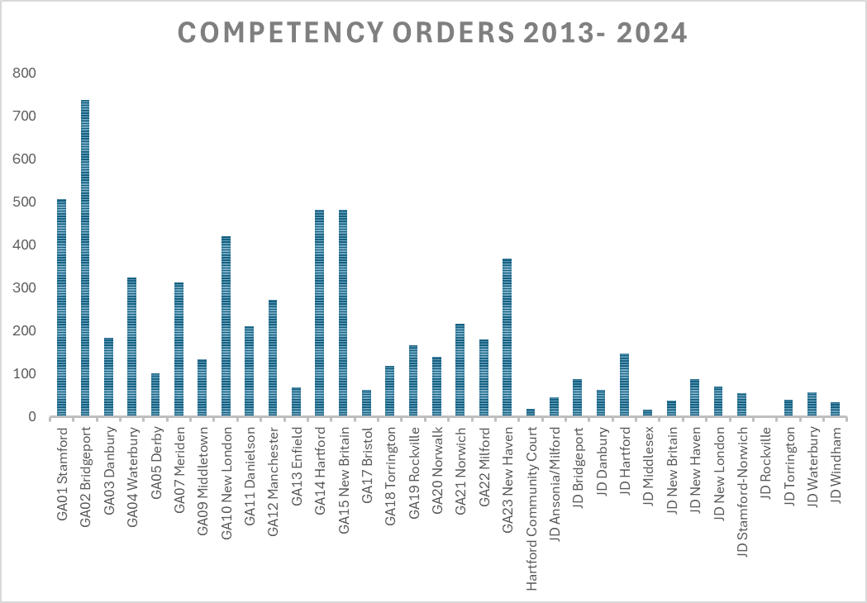
COMPETENCY ORDERS 2013-2024
The number of evaluations ordered in each court is not directly related to the volume seen in each court.
Comparatively, Bridgeport, Stamford, Meriden, and New London have higher percentages of competency orders.
We do not currently have data on other possible contributing factors (party requesting the evaluations, when the evaluation is ordered, demographics of the defendants, court utilization of diversion services, availability of clinical services in the area)
Mental Health and Addiction Services

Slide 21
Year | Number of Misdemeanor Cases (%) | Number of Felony Cases (%) | Total (%)
2013 | 189 | 313 | 502
 | 37.6% | 62.4% | 100.0%
2014 | 213 | 344 | 557
 | 38.2% | 61.8% | 100.0%
2015 | 197 | 367 | 564
 | 34.9% | 65.1% | 100.0%
2016 | 217 | 346 | 563
 | 38.5% | 61.5% | 100.0%
2017 | 200 | 385 | 585
 | 34.2% | 65.8% | 100.0%
2018 | 195 | 373 | 568
 | 34.3% | 65.7% | 100.0%
2019 | 238 | 407 | 645
 | 36.9% | 63.1% | 100.0%
2020 | 93 | 190 | 283
 | 32.9% | 67.1% | 100.0%
2021 | 133 | 327 | 460
 | 28.9% | 71.1% | 100.0%
2022 | 181 | 357 | 538
 | 33.6% | 66.4% | 100.0%
TOTAL | 1856 | 3410 | 5266
 | 35.2% | 64.8% | 100.0%
seriousness of Charges in CST Evaluation Cases
On average, 35% of CST evaluations are ordered on misdemeanor cases.
Although there was a slight decrease in orders on misdemeanor only cases in 2020 and 2021, likely due to COVID implications, the percentage has otherwise remained relatively stable throughout the 10-year period.
Mental Health and Addiction Services

Slide 22
YEAR | Total Referrals for Restoration | DMHAS Inpatient | DMHAS Outpatient | DDS Outpatient | DCF
2013 | 193 | 180 | 9 | 4 | 0
2014 | 254 | 231 | 7 | 15 | 1
2015 | 238 | 222 | 11 | 4 | 1
2016 | 249 | 218 | 24 | 6 | 1
2017 | 216 | 195 | 14 | 7 | 0
2018 | 217 | 190 | 18 | 9 | 0
2019 | 268 | 231 | 20 | 17 | 0
2020 | 101 | 89 | 7 | 4 | 1
2021 | 170 | 158 | 5 | 6 | 1
2022 | 218 | 180 | 31 | 7 | 0
2023 | 258 | 231 | 22 | 4 | 1
2024 | 266 | 239 | 20 | 6 | 1
TOTAL | 2648 | 2364 | 188 | 89 | 7
AVERAGE per Year | 221 (100%) | 197 (89.3%) | 16 (7.1%) | 7 (3.4) | 1 (0.3%)
Restoration Setting
The vast majority of competency restoration occurs in DMHAS programs, either inpatient or outpatient
An average of 10.5% of restoration cases were handled as outpatients, including 7.1% in DMHAS programs and 3.4% in DDS programs. The remaining cases were referred to Whiting Forensic Hospital.
Mental Health and Addiction Services

Slide 23
An initial look at 2025 Trends
The total number of completed competency evaluations is likely to be comparable to the number of completed evaluations last year (561).
Currently, 47% of individuals evaluated have been found competent. This is comparable to last year’s data (47.8%) but is lower than the 12 year average of 54% and is the lowest percentage during that time frame.
Of those individuals found to be NC/R to date,
79% have been ordered to Whiting for inpatient restoration compared to 89.8% last year.
21% have been ordered to outpatient restoration compared to 10.2% last year.

