Slide 1

Pretrial Misdemeanor Exploration: Client Case Flows, Length of Stay, and Charges Pending

Slide 2
Navigation: Rounding Out Case Flows Discussion from Last Meeting
From Mike Hines, we learned that there are ~200 misdemeanor only clients in pretrial detention on any given day, many of them are clients with several FTAs, significant criminal histories, severe behavioral health needs, and multiple pending charges.
From Bryan Sperry's discussion of case flows, we learned that in 2024 around ~3,300 misdemeanor defendants were held and transported to DOC pretrial, representing about 5% of total misdemeanor arrestees.
Findings from this week:
  I've found this 5% misdemeanor detention rate has remained consistent through 2018-2023
  From 2018-2023, there were 442,198 misdemeanor arrests. Out of these arrests, 19,402 defendants were detained following the conclusion of arraignment (~4 percent). Focusing only on the few hundred misdemeanants detained pretrial on any given day can obscure the total number of defendants detained for at least one day over the course of a year.
  Not all misdemeanor arrestees detained are facing misdemeanor As.
  Release rates varied across courthouse.
Please hold questions and comments until the end of this section.

Slide 3
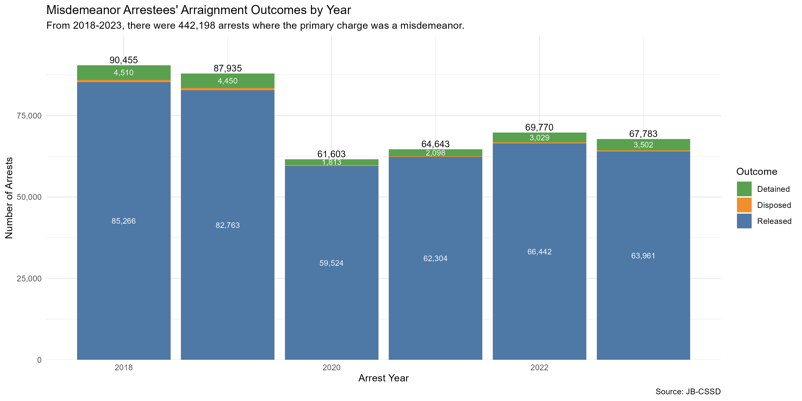
Case Flows: Court Sessions Outcomes
From 2018-2023, there were 442,198 arrests made where the primary charge was a misdemeanor.
Most misdemeanor arrests do not directly lead to a DOC admission.
From 2018-2023, misdemeanor release rates, defined as the portion of arrestees released by the conclusion of arraignment, ranged from 95% to 97%, peaking in pandemic years.
​​

Slide 4
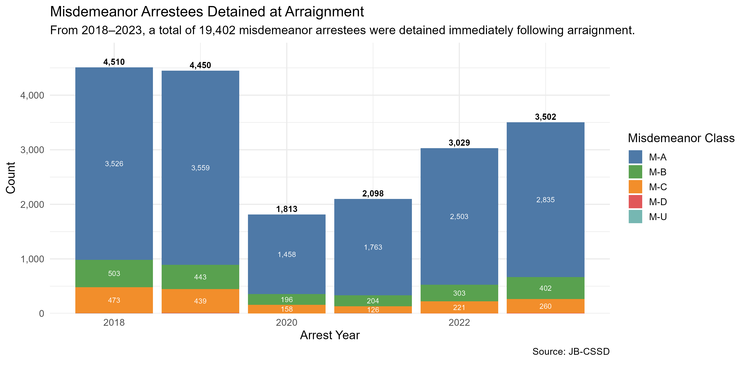
Case Flows: Detention at Arraignment
Despite high release rates, a non-negligible number of misdemeanor arrestees are detained following arraignment.
Among arrests where the primary charge was a misdemeanor, 19,402 arrestees were detained at arraignment from 2018-2023.​
​
Across the six years, an average of 3,234 misdemeanor arrestees were detained each year at arraignment.
A total of 662 clients were facing misdemeanor Bs and Cs in 2023.
Focusing solely on release rates may obscure the raw number of individuals detained for at least one day in DOC and the type misdemeanor charges pending at the time of admission.

Slide 5
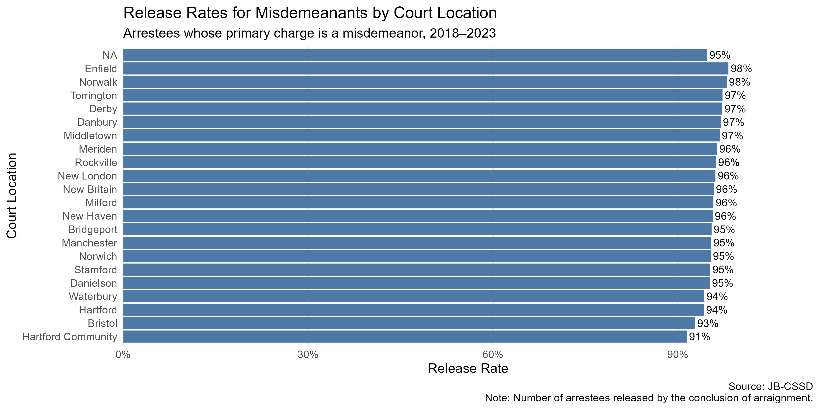
Variation in Release Rates by Court
While the overall release rate is high, there is variation from courthouse to courthouse that may warrant further investigation.
Plausible explanations
  Differing offender populations?
  Differences in judicial culture?
  Differences in how police use their discretion when charging?
  COVID variation?
During pandemic years most courthouses, significantly increased their release rates, some close to 100% (particularly Enfield, Norwalk, and Manchester).
Did releasing more defendants during that period decrease public safety or increase FTA? Could release rates return to elevated pandemic levels safely?

Slide 6
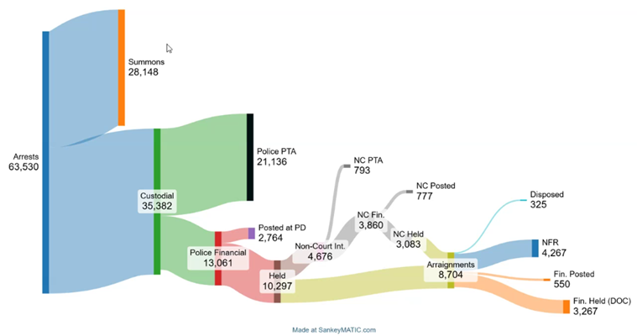
2024 Misdemeanor Case Flows (CSSD Slide)
Among misdemeanor clients in 2024, we know that at least 4,091 paid some monetary amount to secure release.
Who are these defendants? Are they less risky?
How much money did misdemeanants pay to secure release in 2024? How much was refundable?

Slide 7
Navigation: Length of Stay and Bonds
Questions?
Given now what we know about case flows, what can we ascertain about misdemeanor length of stay?
Preliminary findings:
  Half of misdemeanor-only defendants admitted in 2023, stayed for less than or equal to 28 days.
  From 2018-2023, most pretrial detainees facing only misdemeanor charges were held on bonds under $25,000.​
  Misdemeanor arrestees' median length of stay increased from 2018 to 2023, across most bond amount categories.
    In 2022-2023, a larger percentage of misdemeanor detainees are held on bonds over $25,000, compared to 2018-2019.​
    The most common charges facing misdemeanor only arrestees include interfere with officer/resisting, possession of a controlled substance 1st offense, assault 3rd degree and criminal trespass 1st degree. This remained relatively constant from 2018-2023.​
    Number of pending charges per misdemeanor detainee has increased from 2018 to 2023, with the average number of cases pending landing around 6.​
    Over 40% of misdemeanor pretrial detainees have at least one FTA pending at the time of admission. Percent of detainees with at least one FTA pending at admission increased during the study period. ​

Slide 8
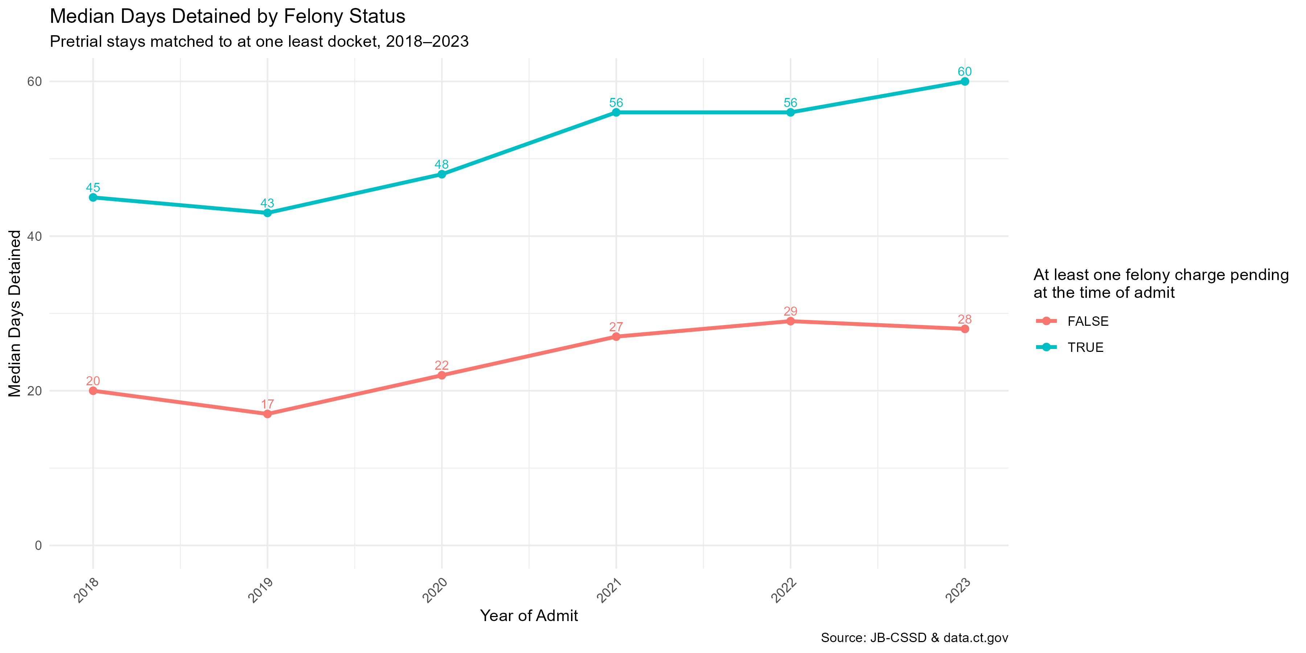
Length of Stay Trends
From 2018 to 2023, the median days detained increased for both misdemeanor only and felony defendants.
Felony defendants remain detained for ~25 days longer.
What are the benefits of a short stay in detention? Does a short pretrial stay in DOC, without services, increase the likelihood of future offending?
Why did LoS increase? Did it increase for all bond categories?
Notes:
We know that a small portion of misdemeanor arrestees are detained following arraignment. How long are these misdemeanor arrestees detained for however?

Slide 9
Unique Misdemeanor Pretrial Stays by Bond Category: 2018-2019
What is the pre-pandemic baseline?
Among those admitted from 2018 to 2019, there were ~8,022 pretrial detainees who only had misdemeanor charges pending at the time of admission.
65% of detainees had bonds under $25,000.
Overall, about half of misdemeanants were detained for less than 18 days.
Misdemeanor Bond Category* | Count of Stays | Percent | Median Days Detained
Under $1,000 | 403 | 5% | 3
$1,000-$4,999 | 1,556 | 19% | 8
$5,000-$9,999 | 1,249 | 16% | 14
$10,000-$24,999 | 1,992 | 25% | 21
$25,000-$49,999 | 1,179 | 15% | 35
$50,000+ | 1,643 | 20% | 43
Total | 8,022 | 100% | 18
*Note: The bond category is created by using the max bond amount that was imposed during the pretrial stay.
Source: JB-CSSD & data.ct.gov. DOC pretrial stays matched to dockets pending at the time of admit.

Slide 10
Unique Misdemeanor Pretrial Stays by Bond Category: 2022-2023
In 2022-2023, there were fewer pretrial admissions, length of stay increased, and the portion of defendants detained on bonds above $25,000 increased, compared to 2018-2019.
Among those admitted from 2022 to 2023, there were ~5,464 pretrial detainees who only had misdemeanor charges pending at the time of admission, a decrease from 8,022 admissions during the 2018-2019 period.
58% of detainees had bonds under $25,000, down from 65% from 2018-2019.
Increases in bond amounts alone do not explain the observed increases in LoS. LoS increased across the board. Did the charges clients face change?
Misdemeanor Bond Category* | Count of Stays | Percent | Median Days Detained
Under $1,000 | 151 | 3% | 5**
$1,000-$4,999 | 796 | 15% | 9**
$5,000-$9,999 | 866 | 16% | 14
$10,000-$24,999 | 1,372 | 25% | 30**
$25,000-$49,999 | 921 | 17%** | 38**
$50,000+ | 1,358 | 25%** | 61**
Total | 5,464 | 100% | 28**
*Note: The bond category is created by using the max bond amount that was imposed during the pretrial stay.
**Note: Indicates an increase from 2018-2019.
Source: JB-CSSD & data.ct.gov. DOC pretrial stays matched to dockets pending at the time of admit.

Slide 11
Ten Most Common Top Charges at Time of Admit, 2018-2019
Ten Most Common Top Charges at Time of Admit, 2022-2023
Charge Name | Count | Percent
INTERFERE WITH OFFCR/RESISTING | 999 | 12%
POS CONTROL SUBSTNCE 1ST OFFNS | 939 | 12%
ASSAULT 3RD DEG | 881 | 11%
CRIMINAL TRESPASS 1ST DEG | 612 | 8%
LARCENY 6TH DEG | 568 | 7%
THREATENING 2ND DEG | 510 | 6%
ILL OPN MV UNDER SUSPENSION | 487 | 6%
ILL OPN MV UNDER INFL ALC/DRUG | 328 | 4%
BREACH OF PEACE 2ND DEG | 304 | 4%
EVADE RESP-INJURY/PROP DAMAGE | 249 | 3%
Charge Name | Count | Percent
INTERFERE WITH OFFCR/RESISTING | 821 | 15%
POS CONTROL SUBSTNCE 1ST OFFNS | 575 | 11%
CRIMINAL TRESPASS 1ST DEG | 541 | 10%
ASSAULT 3RD DEG | 536 | 10%
THREATENING 2ND DEG | 286 | 5%
LARCENY 6TH DEG | 274 | 5%
ILL OPN MV UNDER INFL ALC/DRUG | 245 | 4%
ILL OPN MV UNDER SUSPENSION | 235 | 4%
BREACH OF PEACE 2ND DEG | 219 | 4%
EVADE RESP-INJURY/PROP DAMAGE | 188 | 3%
Source: JB-CSSD & data.ct.gov. DOC pretrial stays matched to dockets pending at the time of admit. Excludes FTA.​
Notes:
The most common charges stay roughly the same. The charges alone do not appear to impact LoS.

Slide 12
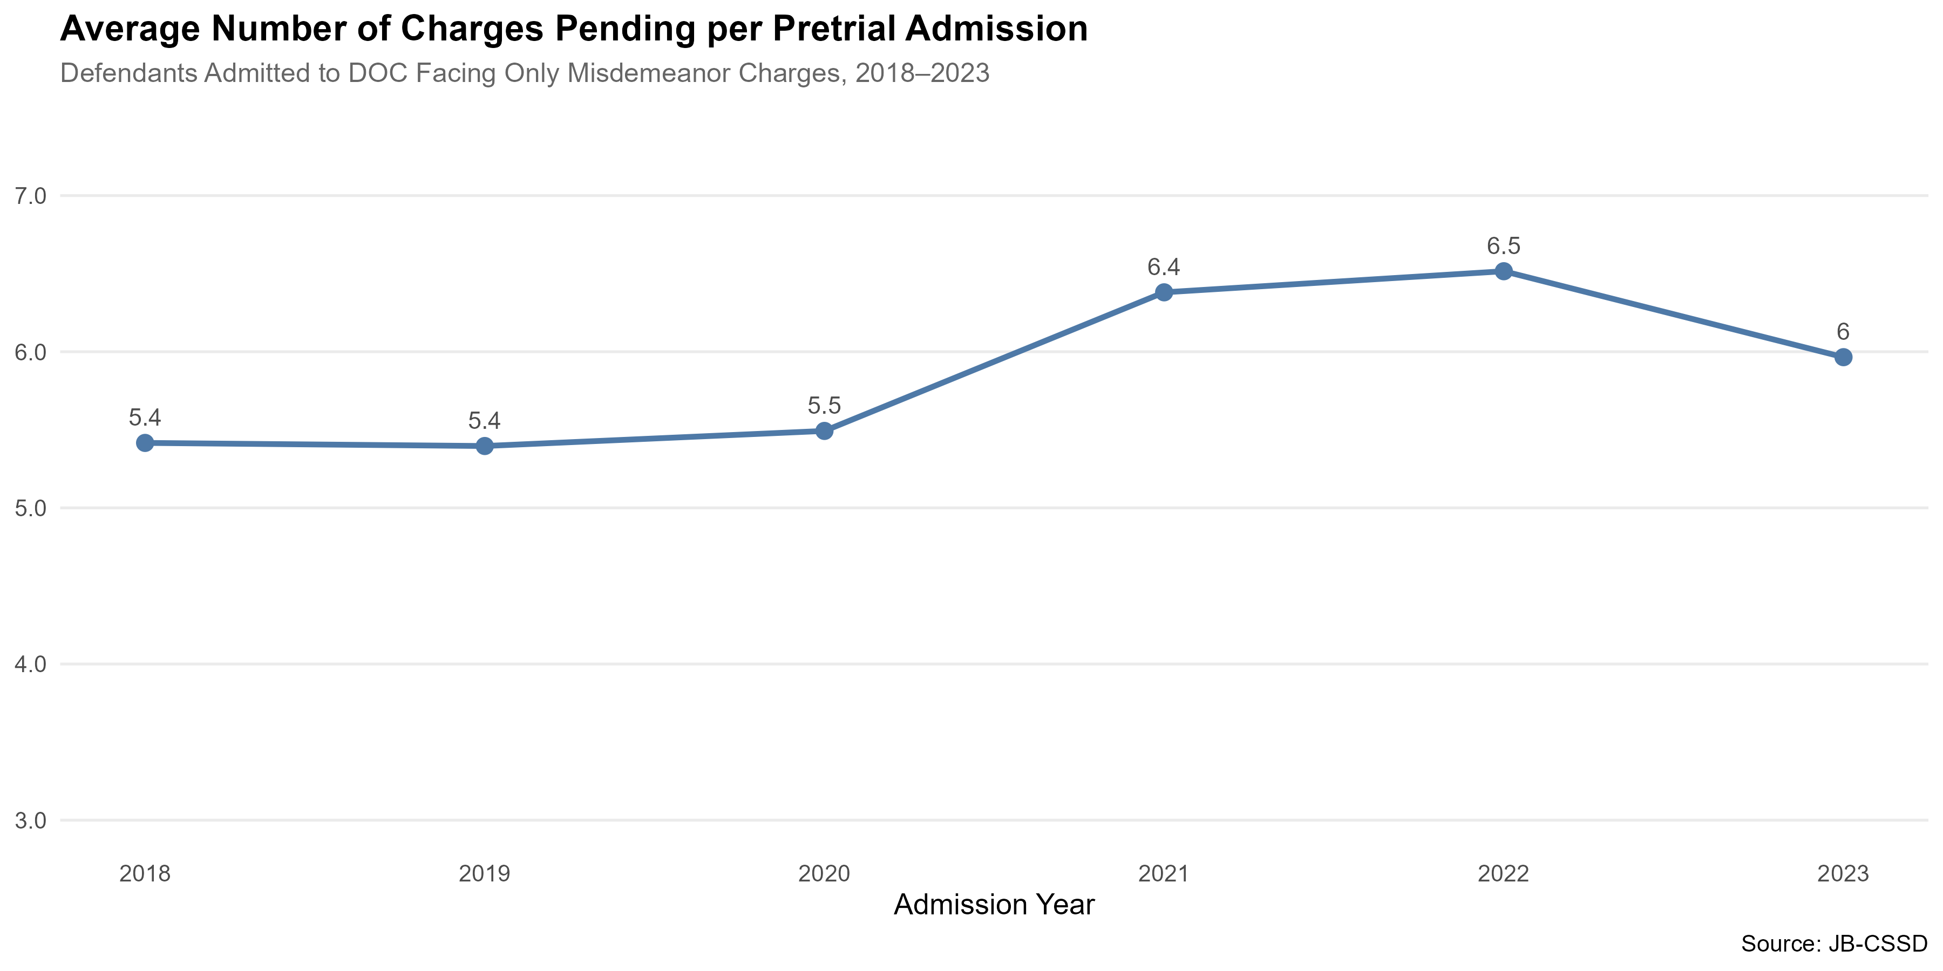
Charges Pending at the Time of Admit
Did the number of pending charges increase?
From 2018 to 2023, the average number of charges pending at the time of a defendant's admission trended upwards.
Plausible explanation for increase in median length of stay?
Are there interventions that could reduce the number of charges filed? ESI?
Source: JB-CSSD & data.ct.gov. DOC pretrial stays matched to dockets pending at the time of admit.​

Slide 13
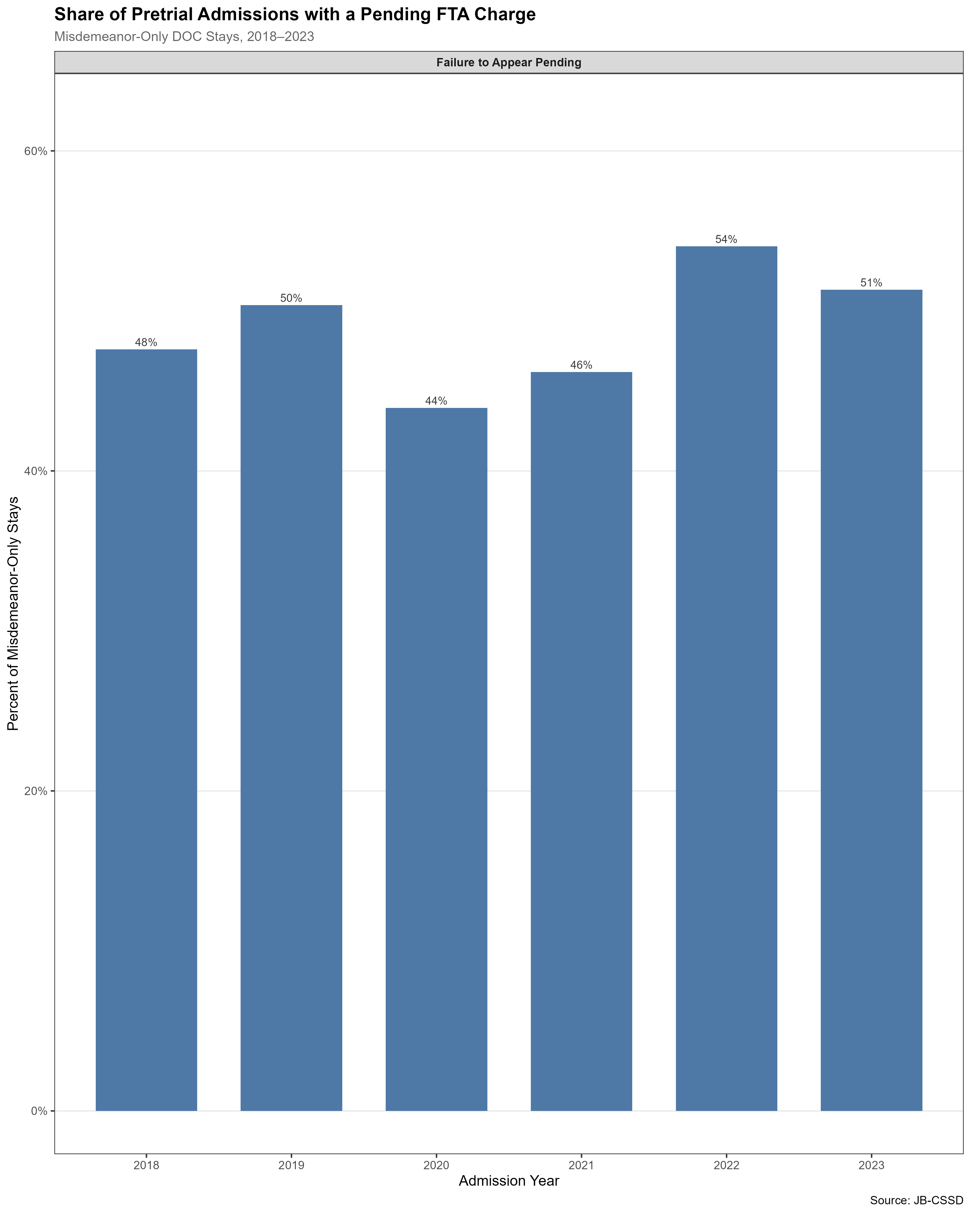
Types of Charges Pending, 2018-2023
Did FTA increase?
44% to 54% of pretrial detainees facing only misdemeanor charges had a failure to appear charge pending at the time of DOC admission. FTA charges facing detainees increased after the pandemic.
As of 12/31/25, there are 38,586 active FTA warrants with 7,215 being felony FTA warrants. (Connecticut Judicial Branch, 2026)
Given how common a history of FTA is among misdemeanor detainees, action to increase appearance rates and change FTA procedures could have a significant impact on this population.
Possible interventions: expanded court reminders, increased usage of bail commissioner letters, clearer summons paperwork, and reduced court appearances? Expanded ESI?

Slide 14
Key Preliminary Points and Discussion
The vast majority of misdemeanor arrestees are released by the time their arraignment concludes (95%-97%).
  However, due to the large number of misdemeanor arrests that occur each year, a significant number of arrests, around 19,402 from 2018 to 2023, lead to at least one day in DOC custody. Evidence has suggested that even short stays in pretrial detention can increase the likelihood that a defendant 1) fails to appear to required court dates (Lowenkamp et al., 2013b), 2) receives a conviction (Stevenson, 2016), 3) receives a harsher sentence (Lowenkamp et al., 2013a), and 4) is charged for a new crime in the future (Heaton & Stevenson, 2016).
  Release rates fluctuate across courthouse and increased over COVID-19. What explains variation by courthouse? How would releasing more misdemeanor-only defendants impact public safety and FTA rates?
Many misdemeanor defendants are held for less than 28 days and on bonds under $25,000.
  How many misdemeanor defendants are detained due to not being able to pay very low bond amounts?
  Does a short pretrial stay in DOC, often without the defendant receiving services, increase the likelihood of future offending?
Misdemeanor LoS increased across most bond groups during the study period:
  The offenses defendants face have stayed relatively the same
  The number of pending charges has increased
  FTAs have increased
  Interventions?
Common charges among misdemeanor only clients include: interfere with officer/resisting, possession of a control substance 1st offense, criminal trespass 1st degree, larceny 6th degree, and illegal operation of motor vehicle under suspension.
  In what situations do these charges warrant detention?
Many misdemeanor arrestees have upwards of 5 or 6 pending charges at the time of admission and 44% to 54% have a failure to appear pending. As of 12/31/25, there are 38,586 active FTA warrants with 7,215 being felony FTA warrants (Connecticut Judicial Branch, 2026).
  Could changes in charging practices at the police department and prosecutor levels reduce detention safely? ESI?
  FTA is a factor in a large portion of pretrial misdemeanor detention decisions, suggesting reforms increase appearance could reduce the size of the pretrial population.
  Are there interventions that could increase court appearance rates that haven't yet been implemented?

Slide 15
Questions ?
Plausible Explanations?
Comments?

Slide 16
References
Connecticut Judicial Branch. (2026). Arrest Warrants Statistics. CT.gov. https://www.jud.ct.gov/statistics/Fail_to_appear.htm
Heaton, P., & Stevenson, M. (2016). The downstream consequences of misdemeanor pretrial detention. SSRN Electronic Journal, 69(3). https://doi.org/10.2139/ssrn.2809840
Lowenkamp, C., VanNostrand, M., & Holsinger, A. (2013a). Investigating the impact of pretrial detention on sentencing outcomes investigating the impact of pretrial detention on sentencing outcomes. Arnold Foundation. https://static.prisonpolicy.org/scans/ljaf/LJAF_Report_state-sentencing_FNL.pdf
Lowenkamp, C., VanNostrand, M., & Holsinger, A. (2013b). The hidden costs of pretrial detention. Arnold Foundation. https://static.prisonpolicy.org/scans/ljaf/LJAF_Report_hidden-costs_FNL.pdf
Stevenson, M. (2016). Distortion of justice: How the inability to pay bail affects case outcomes. Journal of Law, Economics & Organization. https://doi.org/10.2139/ssrn.2777615

