Slide 1
CDOC Self Bond Process AD 3.7

Slide 2
Self Bond Out
In order for an inmate to post their own bond the procedures listed below must be completed accurately. There must be communication between the facility and the Inmate Trust Fund Unit. 860-692-7670

Slide 3
No Partial Bonds are accepted Initial steps
Facility Procedure
Inmate must fill out a Special Request form with his/her counselor.
Payee Information: Transfer to Bond Account
Reason: To pay bond
Amount: Complete dollar amount
Inmate Signature: Inmate must sign and date the Special Request in the presence of the counselor.
Counselor Signature: Counselor must sign and date the Special Request
Approvals: as required by dollar amount
Warden/Dep. Warden: Warden’s or designee signature is required.
FAX to 860-692-7894 attention
Include the Counselor’s name, telephone #, FAX #, and record’s office number and FAX #
Counselor to give original copy of Special Request form and faxed copy of the Inmate Account Statement and Inmate Trust Fax Cover Sheet to the records office.
Inmate Trust Fund Procedures:
Review the Special Request form for accuracy, completeness, and signatures.
Call the facility Record’s Office to verify that the inmate is bonding out.
Transfer funds from the Inmate’s Spendable Account to the Bond Account. Must be done by an FAO or above.
FAX a copy of the Inmate Account Statement indicating the Bond Account balance and dollar amount to confirm the transfer of funds back to the counselor.
Place copy of faxed documents in daily work. Give the original copy to the check writer pending receipt of original Bond paper work

Slide 4
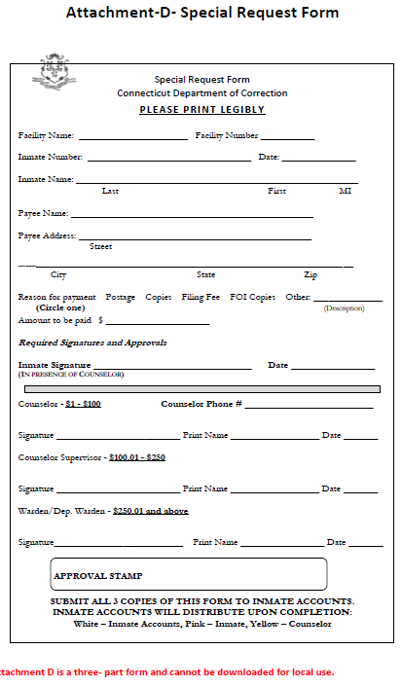

Slide 5
Bonds and Fines 3.7
Only U.S. currency, cashier’s check, certified checks, electronic deposit, or a Department of Correction Inmate Trust Fund check shall be accepted for payment of bonds and fines.
Each Attachment A, Official Receipt (COR-9) shall be recorded in Attachment B, Receipt Journal.
Each journal entry shall be signed by the authorized staff member issuing the receipt.
Each cash bond posted shall be documented in accordance with procedures issued by the Director of Fiscal Services. Bond monies shall be deposited into a bond account within the Inmate Trust Fund.
A check will be issued for each bond/fine from the bond account within the Inmate Trust Fund. Each check shall be made payable to the respective court with the inmate name and number noted in the memo section.
All related documents shall have the receipt number denoted on them and be transmitted with the check to the appropriate court.

Slide 6
Facility Next Steps
Facility
Receipt Rules
Receipt must include:
Received from: Inmate Name
For Inmate: Inmate Name
Docket #
Date you are writing receipt
Inmate #
Housing Unit location
Type of funds received: Place an X in the box marked “Other” and write, “account transfer”
Place an X on line next to the corresponding reason for collection. (“Fine(s) Paid” or “Cash Bail for Court Appearance”)
Dollar amount written legibly opposite the area marked
Total for the Courts
Date of Release
Name of Institution
Time receipt made out
Next Court Date
Court & Address
Signature of person writing the receipt (First & last name written legibly)
Initialed by Supervisor assisting
Upon receipt of confirmation of transfer of funds (FAX cover sheet and inmate account statement), the counselor will then proceed with the appropriate bond out process.
The bond receipt must be made out for the amount of the bond

Slide 7
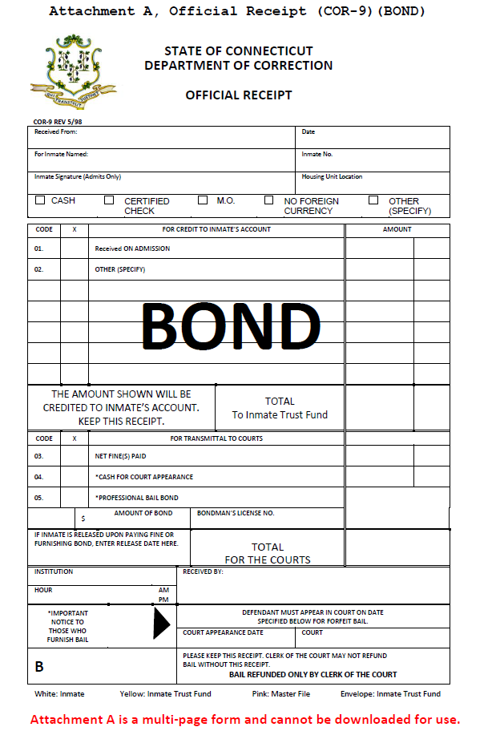

Slide 8
Distribution of Receipt:
White receipt– to inmate
Yellow receipt – attach original signed special request form and the faxed copy of the inmate trust statement and place in the receipt envelope
Pink receipt – attach a copy of the special request form and a copy of the faxed inmate trust statement to the pink receipt and place in the inmate’s master file.
Complete Receipt Journal – indicate on the receipt journal that this is a “account transfer of funds” that no cash was exchanged.
Complete normal bond process In the event the inmate should decide to cancel his request to bond out the counselor must call inmate trust immediately. In addition, the counselor must void the special request by marking VOID across the original special request form. The counselor and inmate must sign and date the form a second time. Fax a copy to the inmate Trust Fund unit, send original via the inmate Trust Fund courier.

