Slide 1

Failure to Appear: Continued

Slide 2
Agenda
We have previously looked into:
Weight given to a history failure to appear in pretrial decision making
The number of active warrants
The number of warrants served and issued every quarter.
Key previous findings:
A large portion of misdemeanants detained pretrial have either a history of failure to appear or a failure to appear charges pending.
~20% of CSSD interviewed arrestees had a failure to appear charge pending at the time of arrest
~44 of CSSD interviewed arrestees had either a history of prior FTA or an active charge
Those who have a history of failure to appear are detained at arraignment at a higher rate than those who do not.
The potential for substance abuse and homelessness to impact FTA rates

Slide 3
Agenda
Outstanding questions:
How many warrants are in relation to a VOP or MV violation offense?
What portion of active warrants are older than five years?
How many warrants are vacated in a given quarter?
Are there differing practices across courts regarding, the number of warrants active, the portion of all warrants that are lingering, and practices around vacating old warrants?

Slide 4
Active Warrants
There are 51,113 FTA warrants active as of February, 2026.

Slide 5
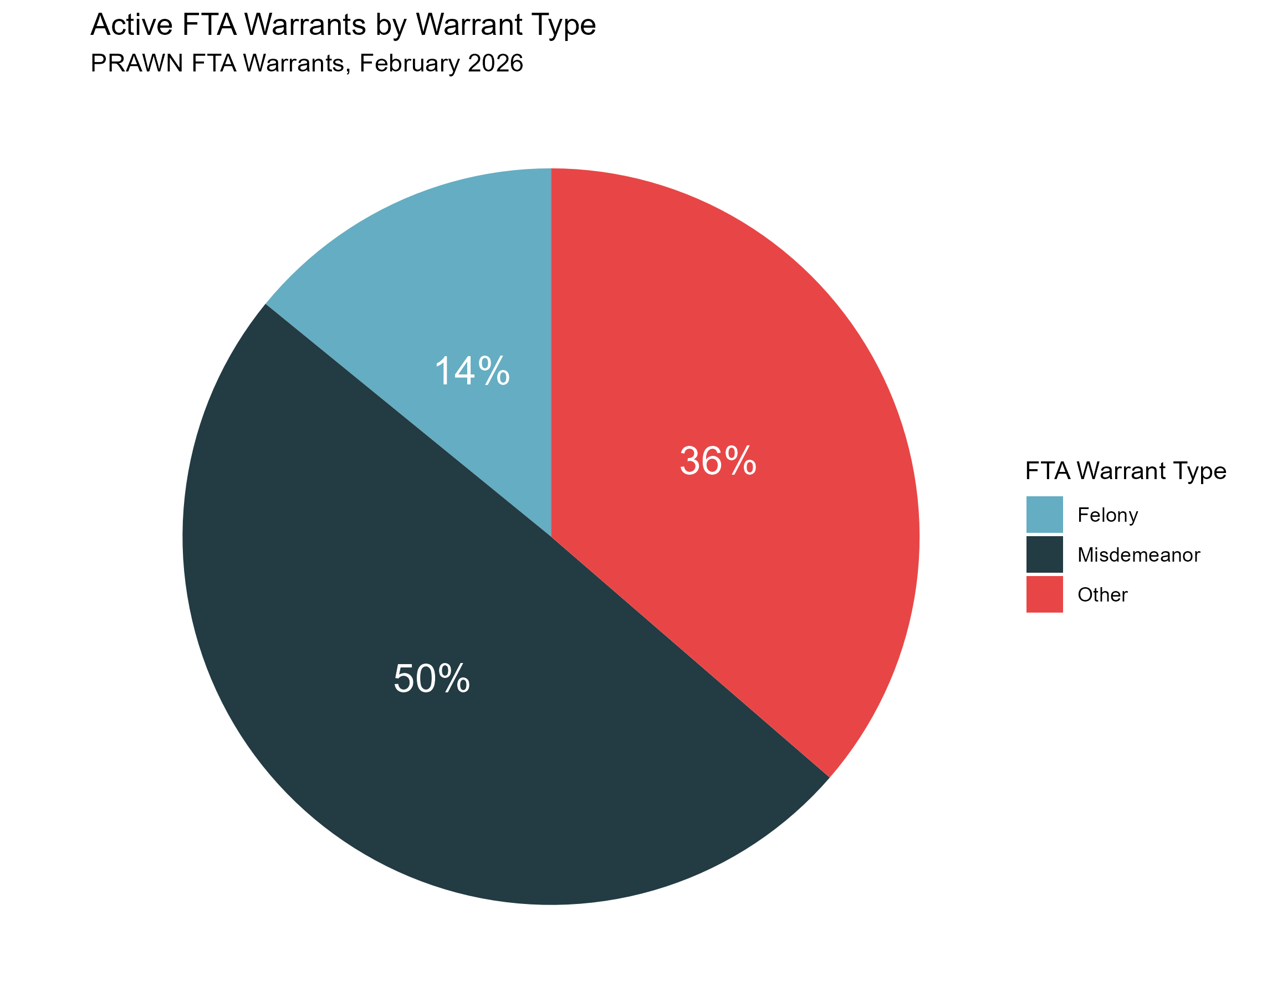
Active Warrants
There are 51,113 FTA warrants active as of February, 2026.

Slide 6
Pause for Discussion
The difference between the number of active FTA warrants most recently posted publicly, 38,586, and this 51,113 figure is 12,527.
The difference is due to the public data only reporting warrants where there is a Connecticut address listed. Cases where there is no CT address or no address listed at all are not included in the public data.
What portion of these 12,527 warrants involve defendants who are unhoused?
More detailed data can help understand the large "other" category
The "other" category includes VOPs that have the underlying charge of a felony or misdemeanor. Work needs to be undertaken to identify the charges underlying VOPs.
The large “other” category likely means that a significant number of MV cases have failure to appears issued on them

Slide 7
There is variation across judicial districts
Judicial District | Percent of active warrants (02-17-2026) | Percent of pending cases (02-17-2026)
Stamford-Norwalk | 15.7% | 10.0%
New Haven | 15.3% | 15.7%
Fairfield | 13.4% | 7.0%
New London | 12.3% | 9.2%
Hartford | 12.0% | 22.0%
New Britain | 6.0% | 8.9%
Danbury | 5.6% | 3.3%
Waterbury | 5.6% | 6.5%
Windham | 3.9% | 3.8%
Ansonia-Milford | 3.8% | 5.2%
Tolland | 2.3% | 2.6%
Litchfield | 2.1% | 2.4%
Middlesex | 2.0% | 3.3%
Stamford-Norwalk, Fairfield (Bridgeport), New London, and Danbury make up a larger portion of FTA warrants than they do cases
Hartford JD is significantly under represented, making up a much larger portion of cases than it does warrants
What can explain these differences?
Are there differing judicial practices surrounding vacating old warrants and issuing new ones?
Community court in Hartford? Less appearances?
Proximity to borders make it more likely for an FTA to be issued and less likely for an warrant to be served?

Slide 8
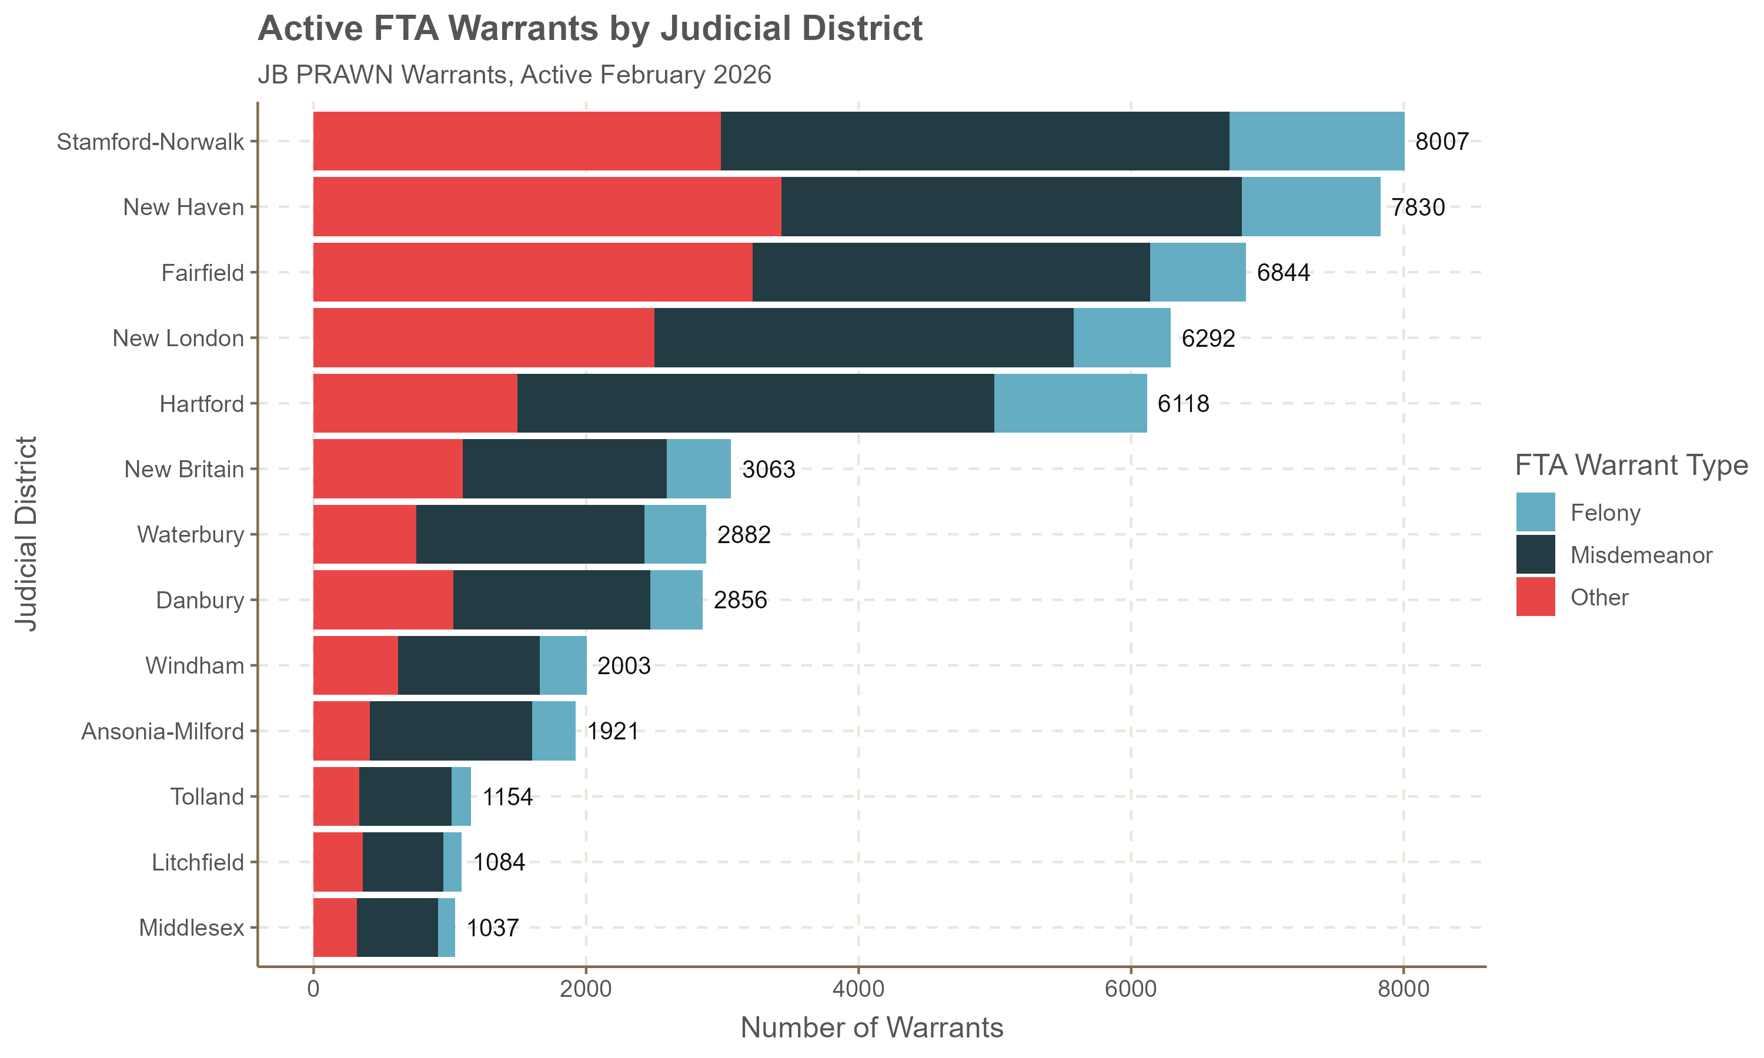
Active Warrants by Judicial District
Stamford-Norwalk, New Haven, Fairfield, New London, and Hartford make up ~68% of active FTA warrants

Slide 9
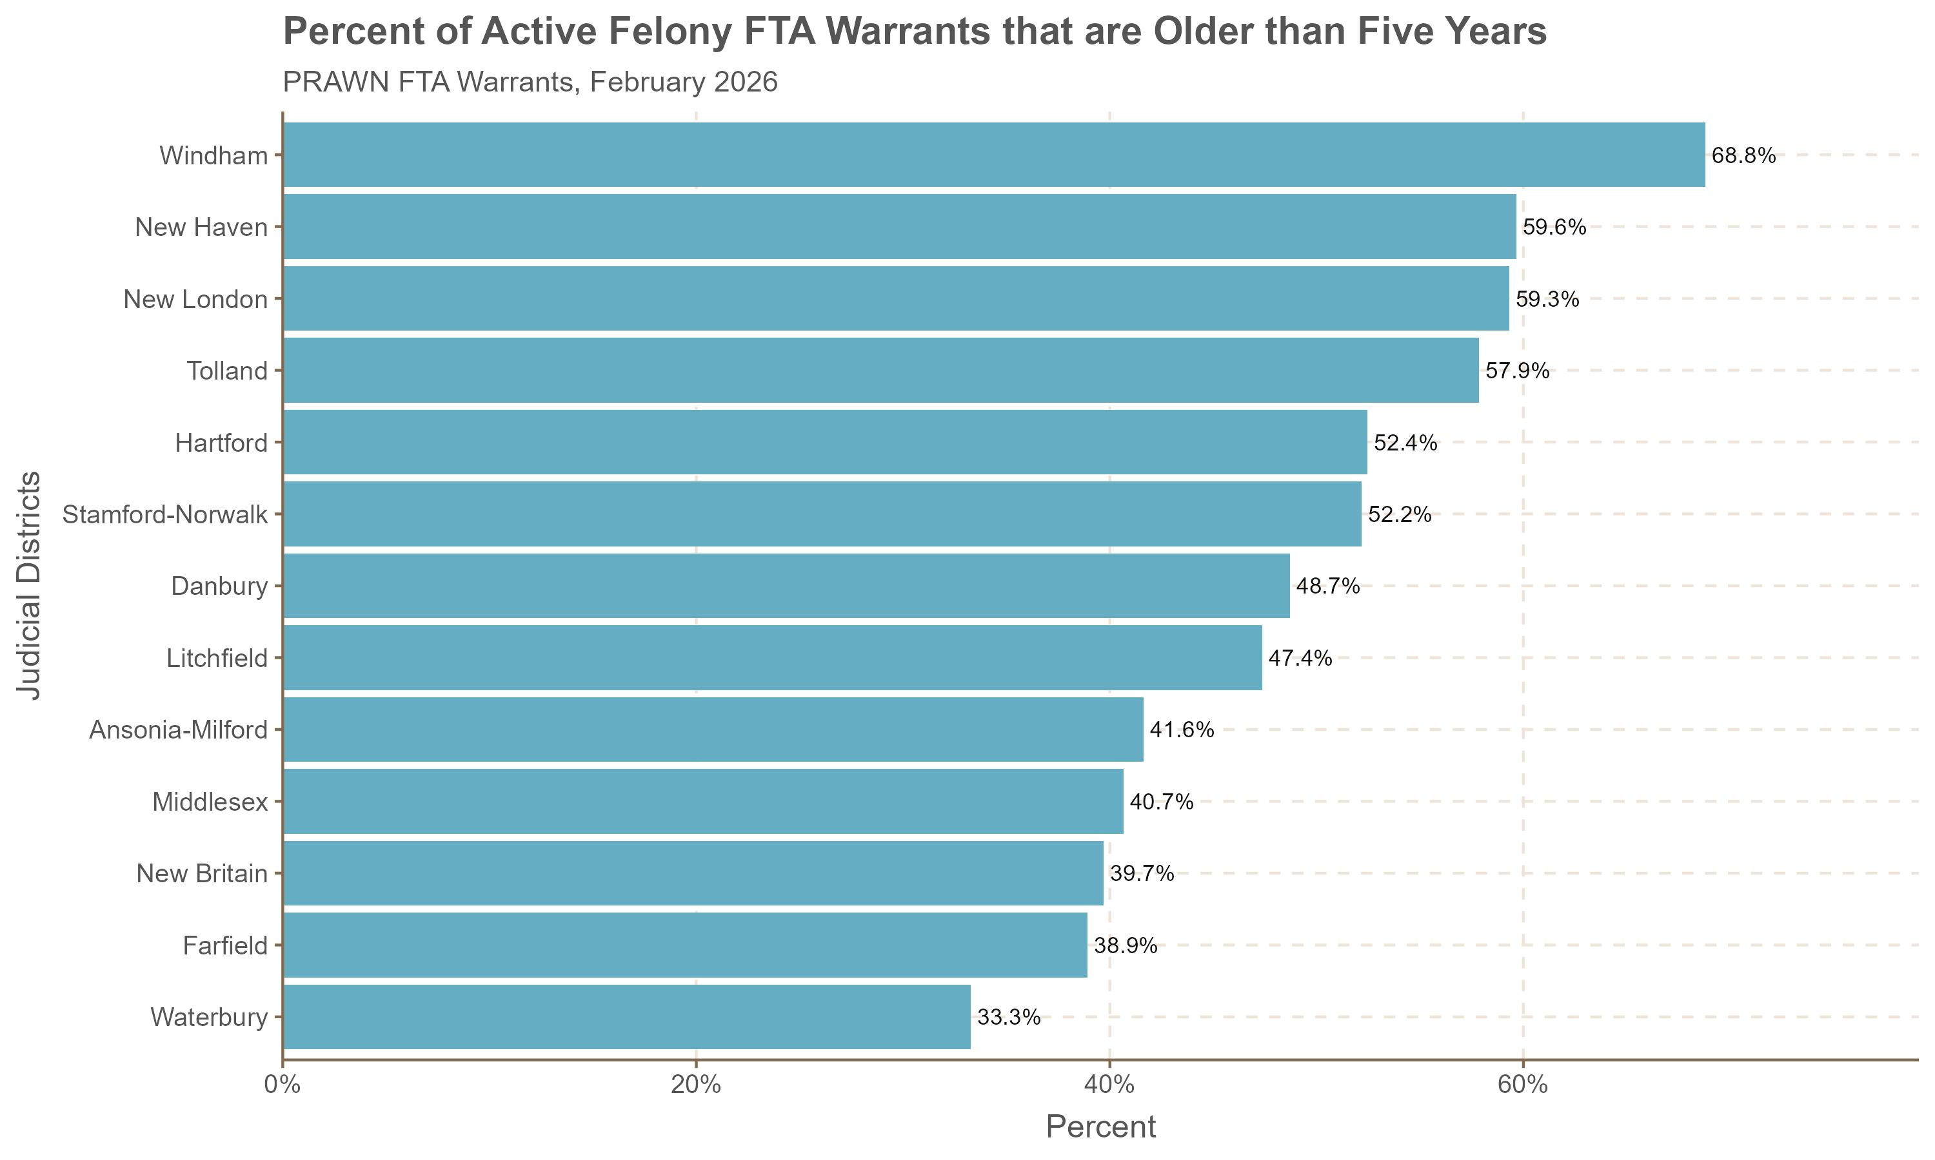
Many felony FTA warrants have been pending a significant period
There is large variation across JDs in terms of lingering felony FTA warrants also.
What the circumstances of these lingering warrants? ​
Individuals incarcerated already? ​
Deceased individuals? ​
Defendants who have truly fled the jurisdiction? ​
Data quality issues?

Slide 10
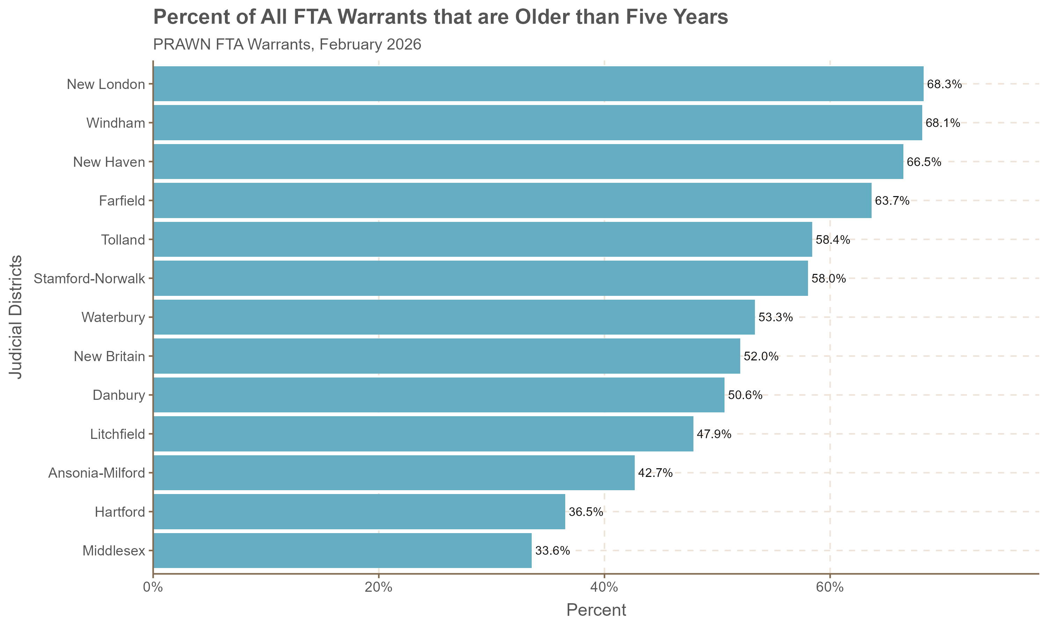
Many FTA warrants have been pending for a long time
Out of the 51,113 active warrants, 29,051 (57%) are older than five years.
Certain judicial districts tend to have warrants that have been pending for much longer than others
What explains these differences?
Likelihood that many of these warrants will ever be served?
The low percent of older warrants in Hartford might help explain the relatively lower portion of overall warrants it makes up, despite caseload.

Slide 11
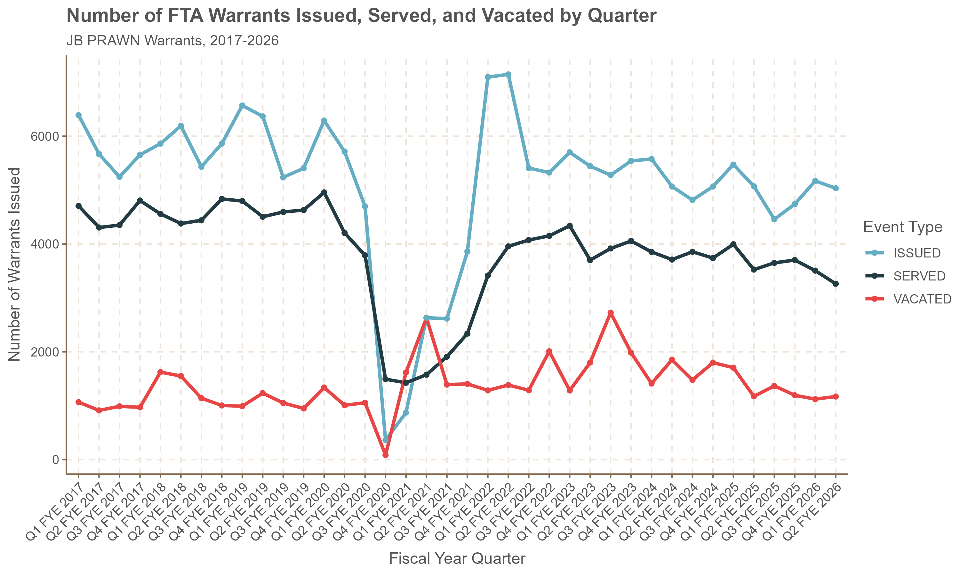
Number of warrants issued, served, and vacated
About 5,000 FTA warrants are issued every quarter.
About 4,000 are served every quarter.
About 1,000 are vacated every quarter.
The number vacated every quarter is subject to large jumps.
In recent quarters, the number of warrants issued has increased while the number of warrants served has decreased.

Slide 12
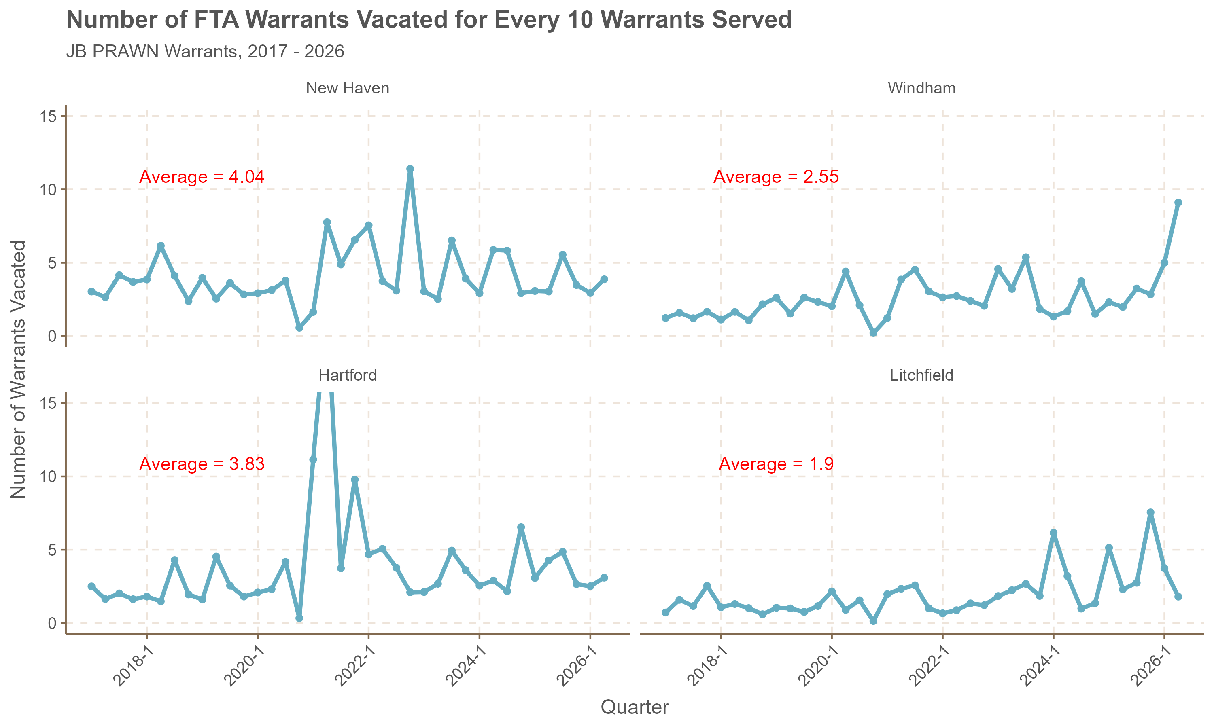
Some judicial districts tend to vacate warrants at a higher rate than others

Slide 13
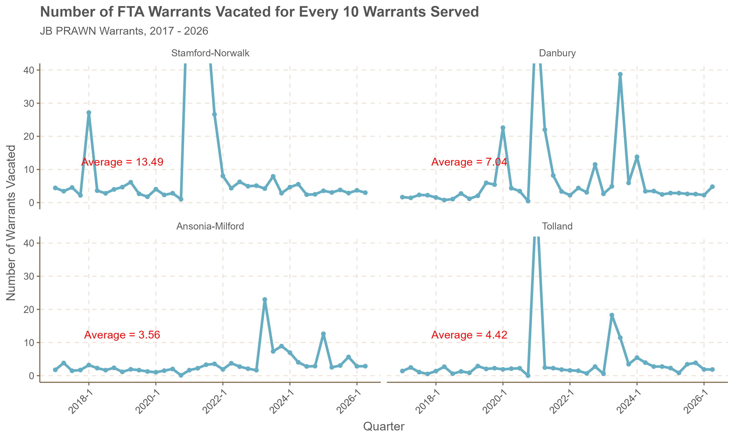
In some districts there has been large variation in the number vacated each quarter

Slide 14
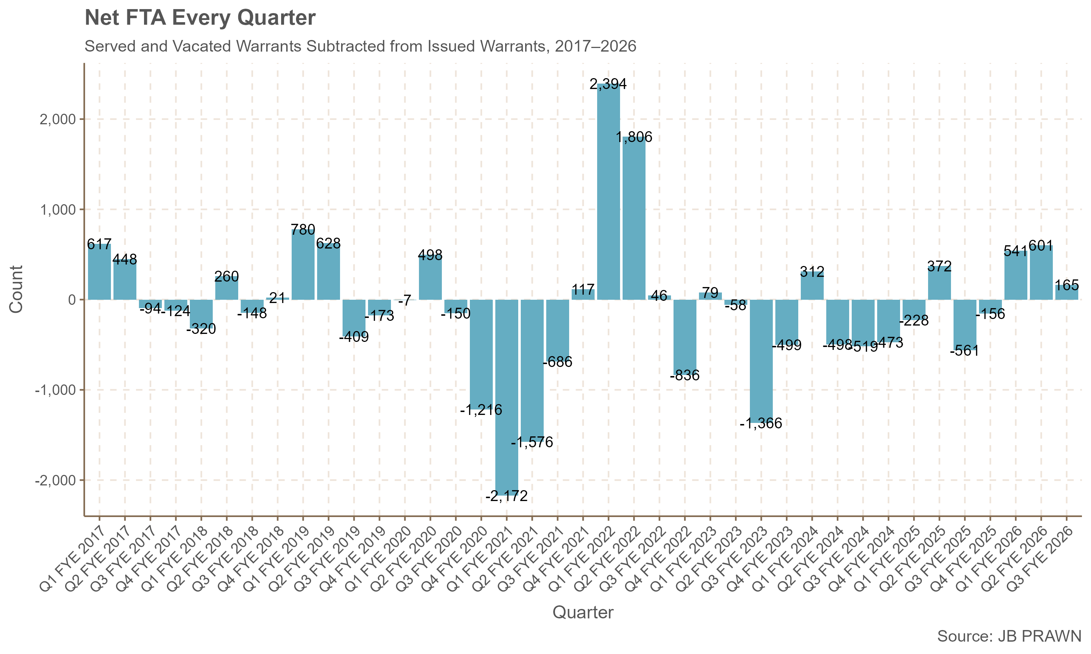
FTA Warrant backlog increasing in recent quarters
In quarters where the bar is negative, it means that the backlog of FTA warrants decreased.
In quarters where the bar is positive, it means the backlog in FTA warrants increased.
The decrease seen in Q3 FYE 2023 corresponds with a large spike in the number of warrants vacated in that quarter.
In recent quarters, the backlog has been increasing, reversing a relatively stable trend since the end of COVID

Slide 15
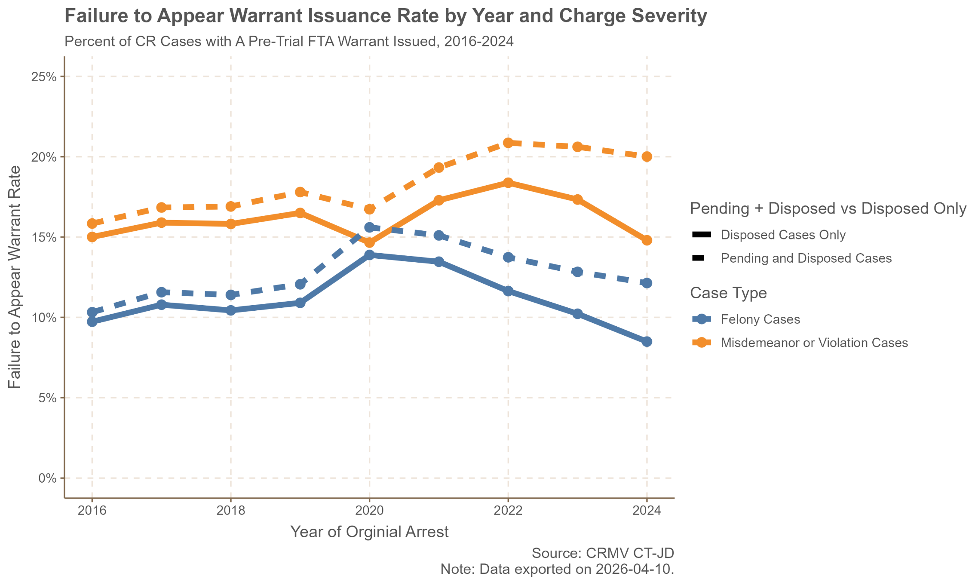
Estimated Failure to Appear Warrant Rate

Slide 16
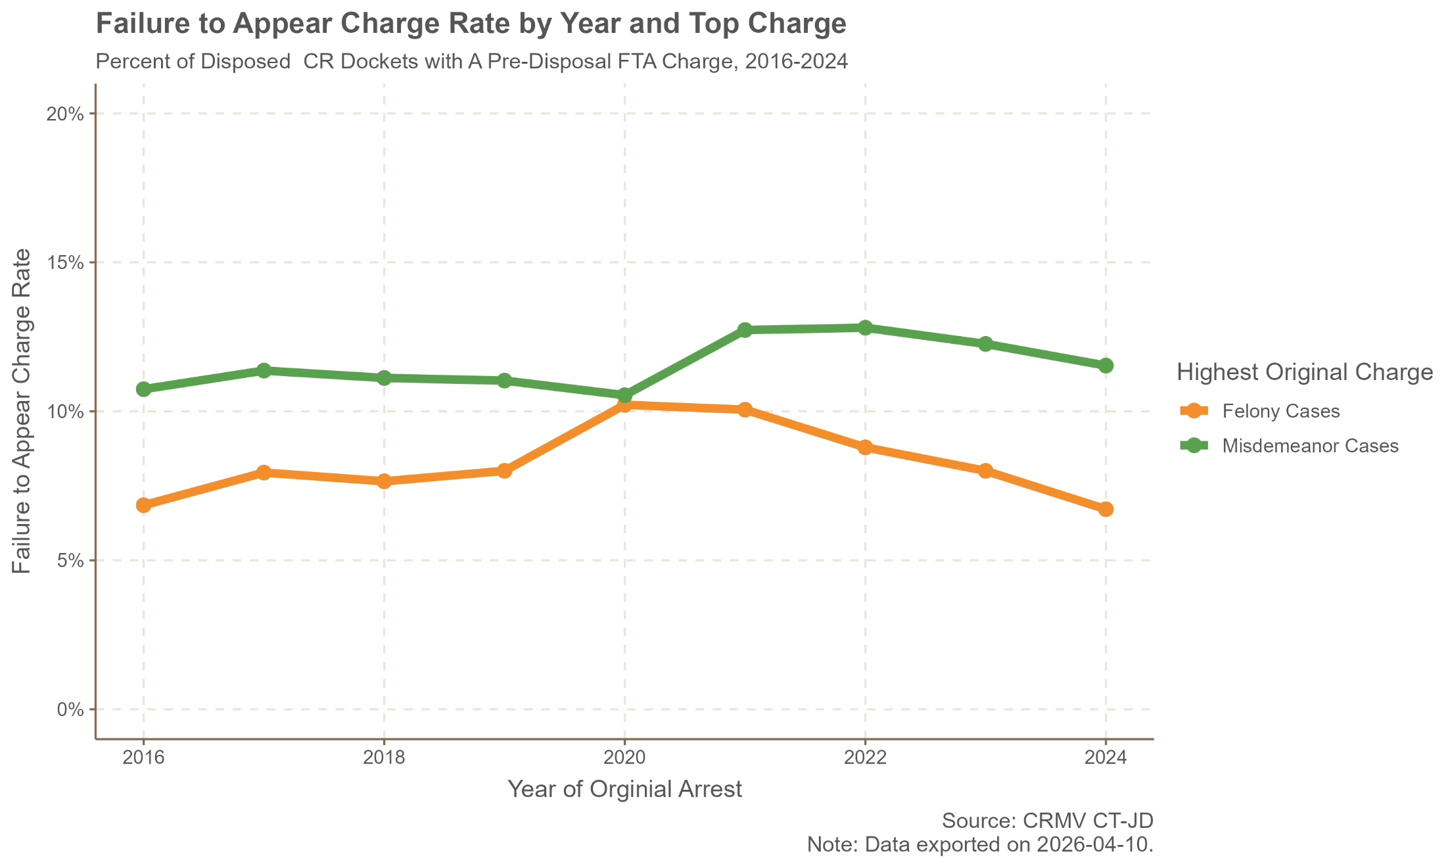
Estimated Failure to Appear Charge Rate

Slide 17
Discussion
What is the most appropriate empirical measure that captures system performance?
The FTA warrant rate among all cases tends to be higher than only disposed cases
Pros:
Captures cases where an FTA warrant is issued and the case is never disposed
Less sensitive to right censoring (less of a lagging indicator)
Cons:
Cases that are still pending have an opportunity to fail to appear
The FTA warrant issuance rate tends to be higher than the FTA charge rate.
Shows prosecutorial discretion?
Does the charge rate capture willful failure to appear better?
This data captures the percentage of cases that involve an FTA, not the percentage of defendants who fail to appear. A limitation is that one person may fail to appear across multiple dockets.

Slide 18
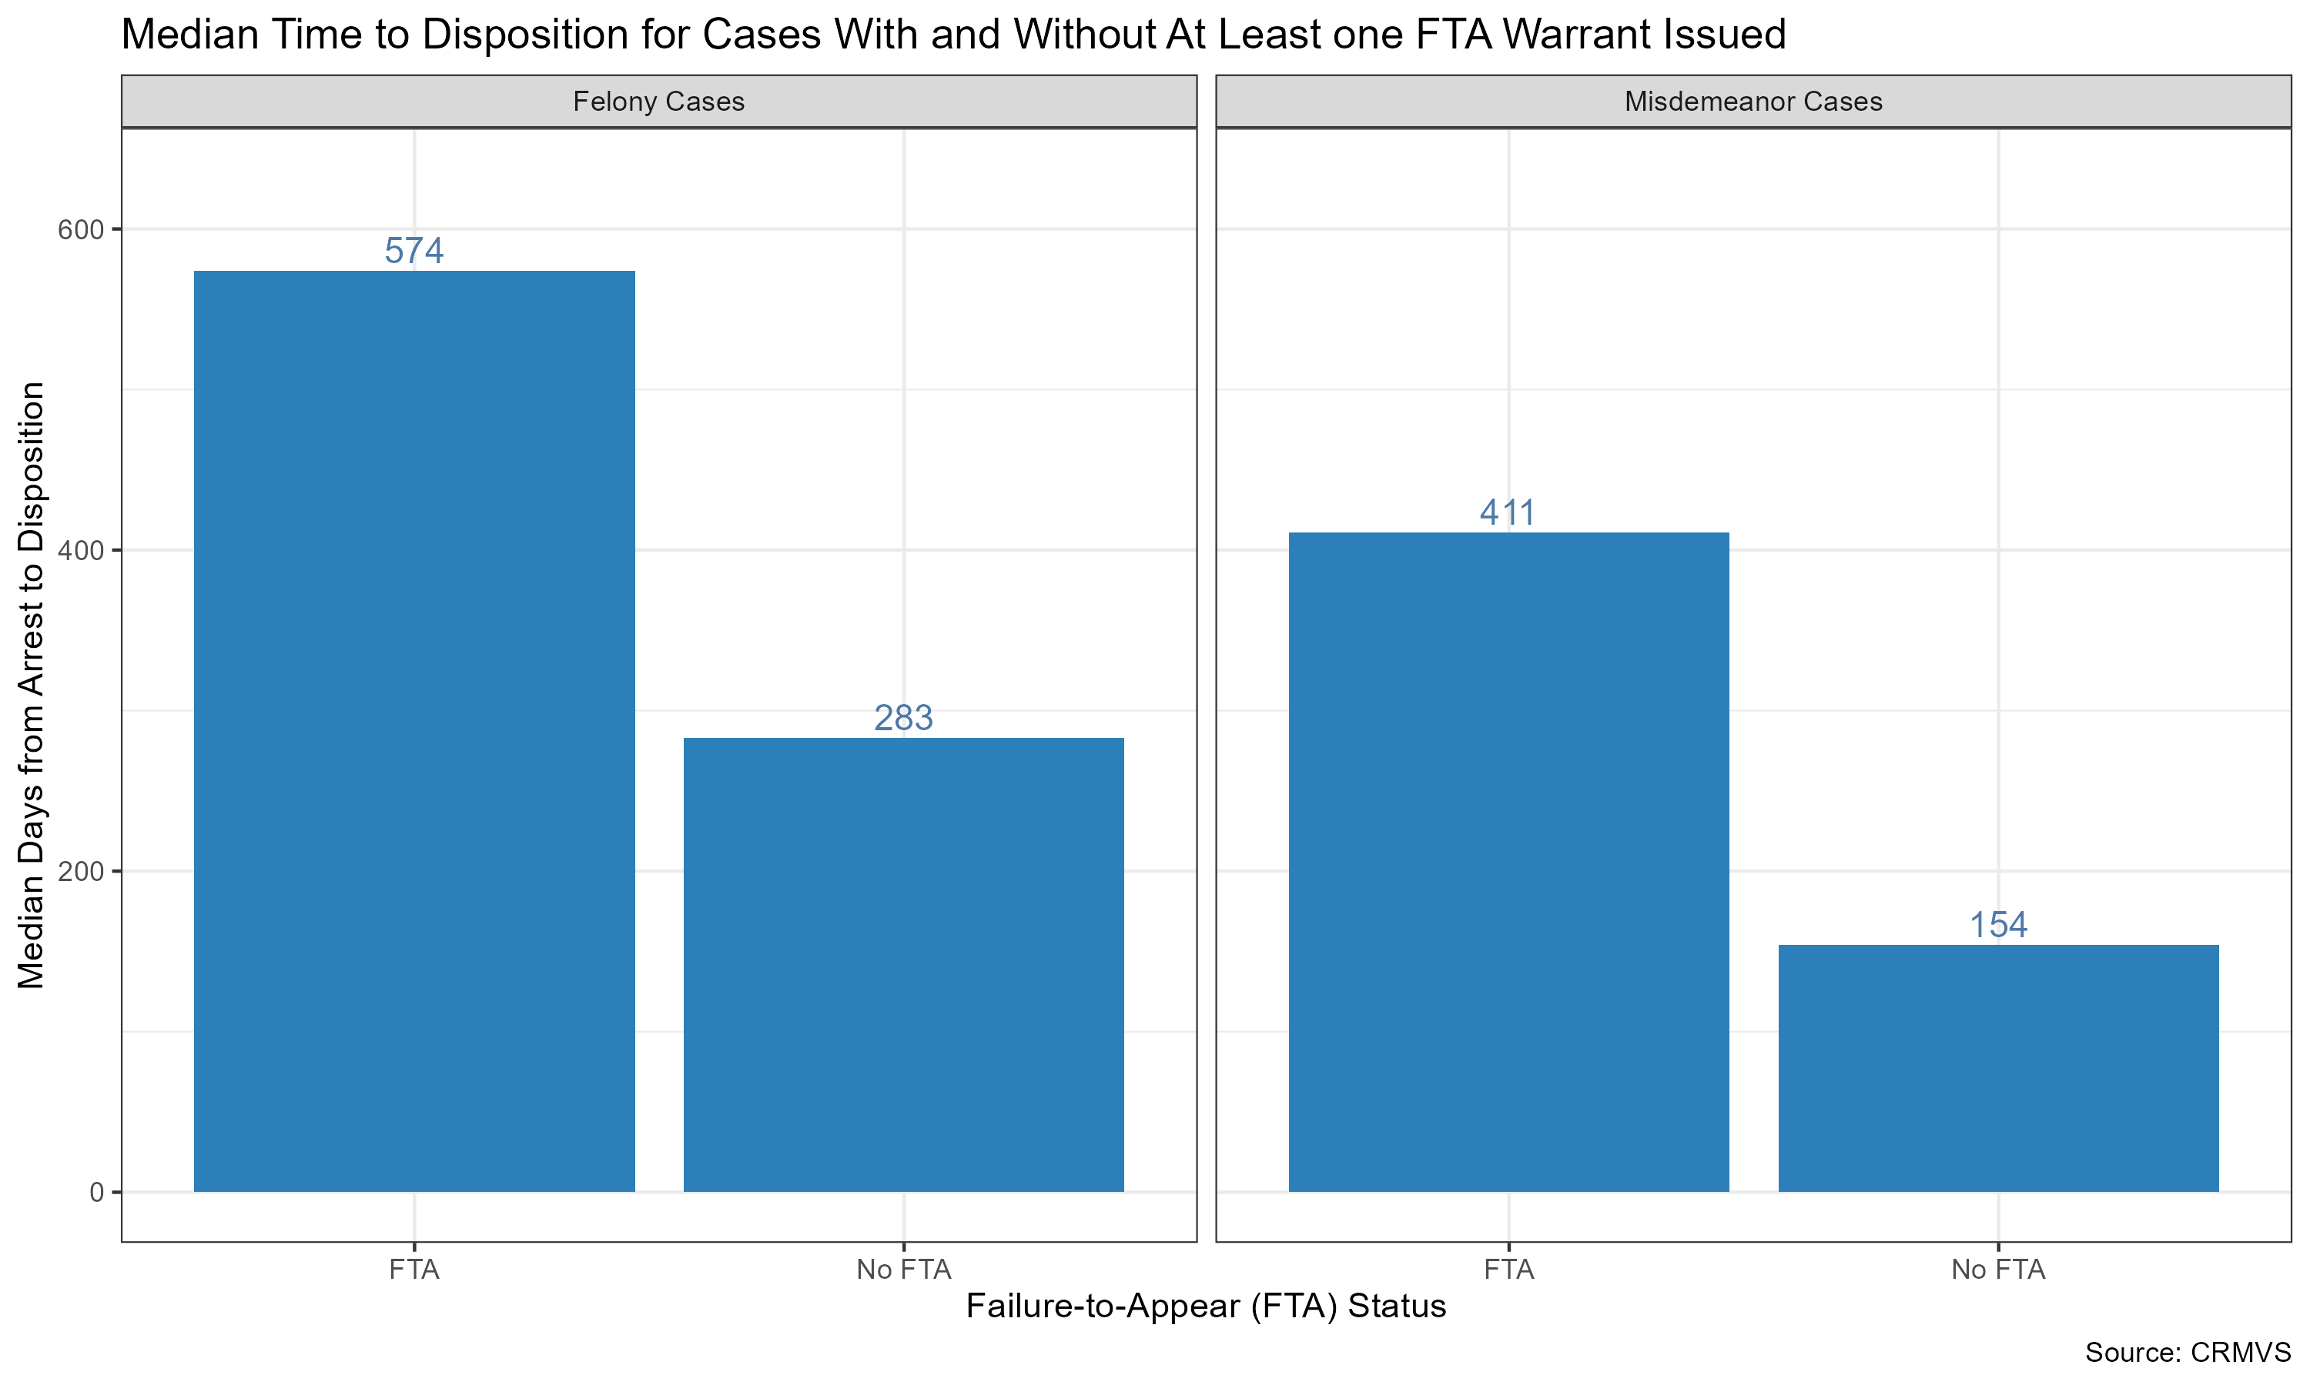
Median CR Case Dispositions

Slide 19
Potential Reverse Causality and Other Factors?
Cases that involve the occurrence of an FTA tend to take longer to dispose
FTAs likely causes delays in court processing
Missed court dates (likely more than one)
Time to resolve the warrant
Cases that take longer to dispose may be more likely to pick up an FTA
More court appearances and hence opportunity for FTA
Longer periods of time between court appearances might increase the likelihood of an FTA

Slide 20
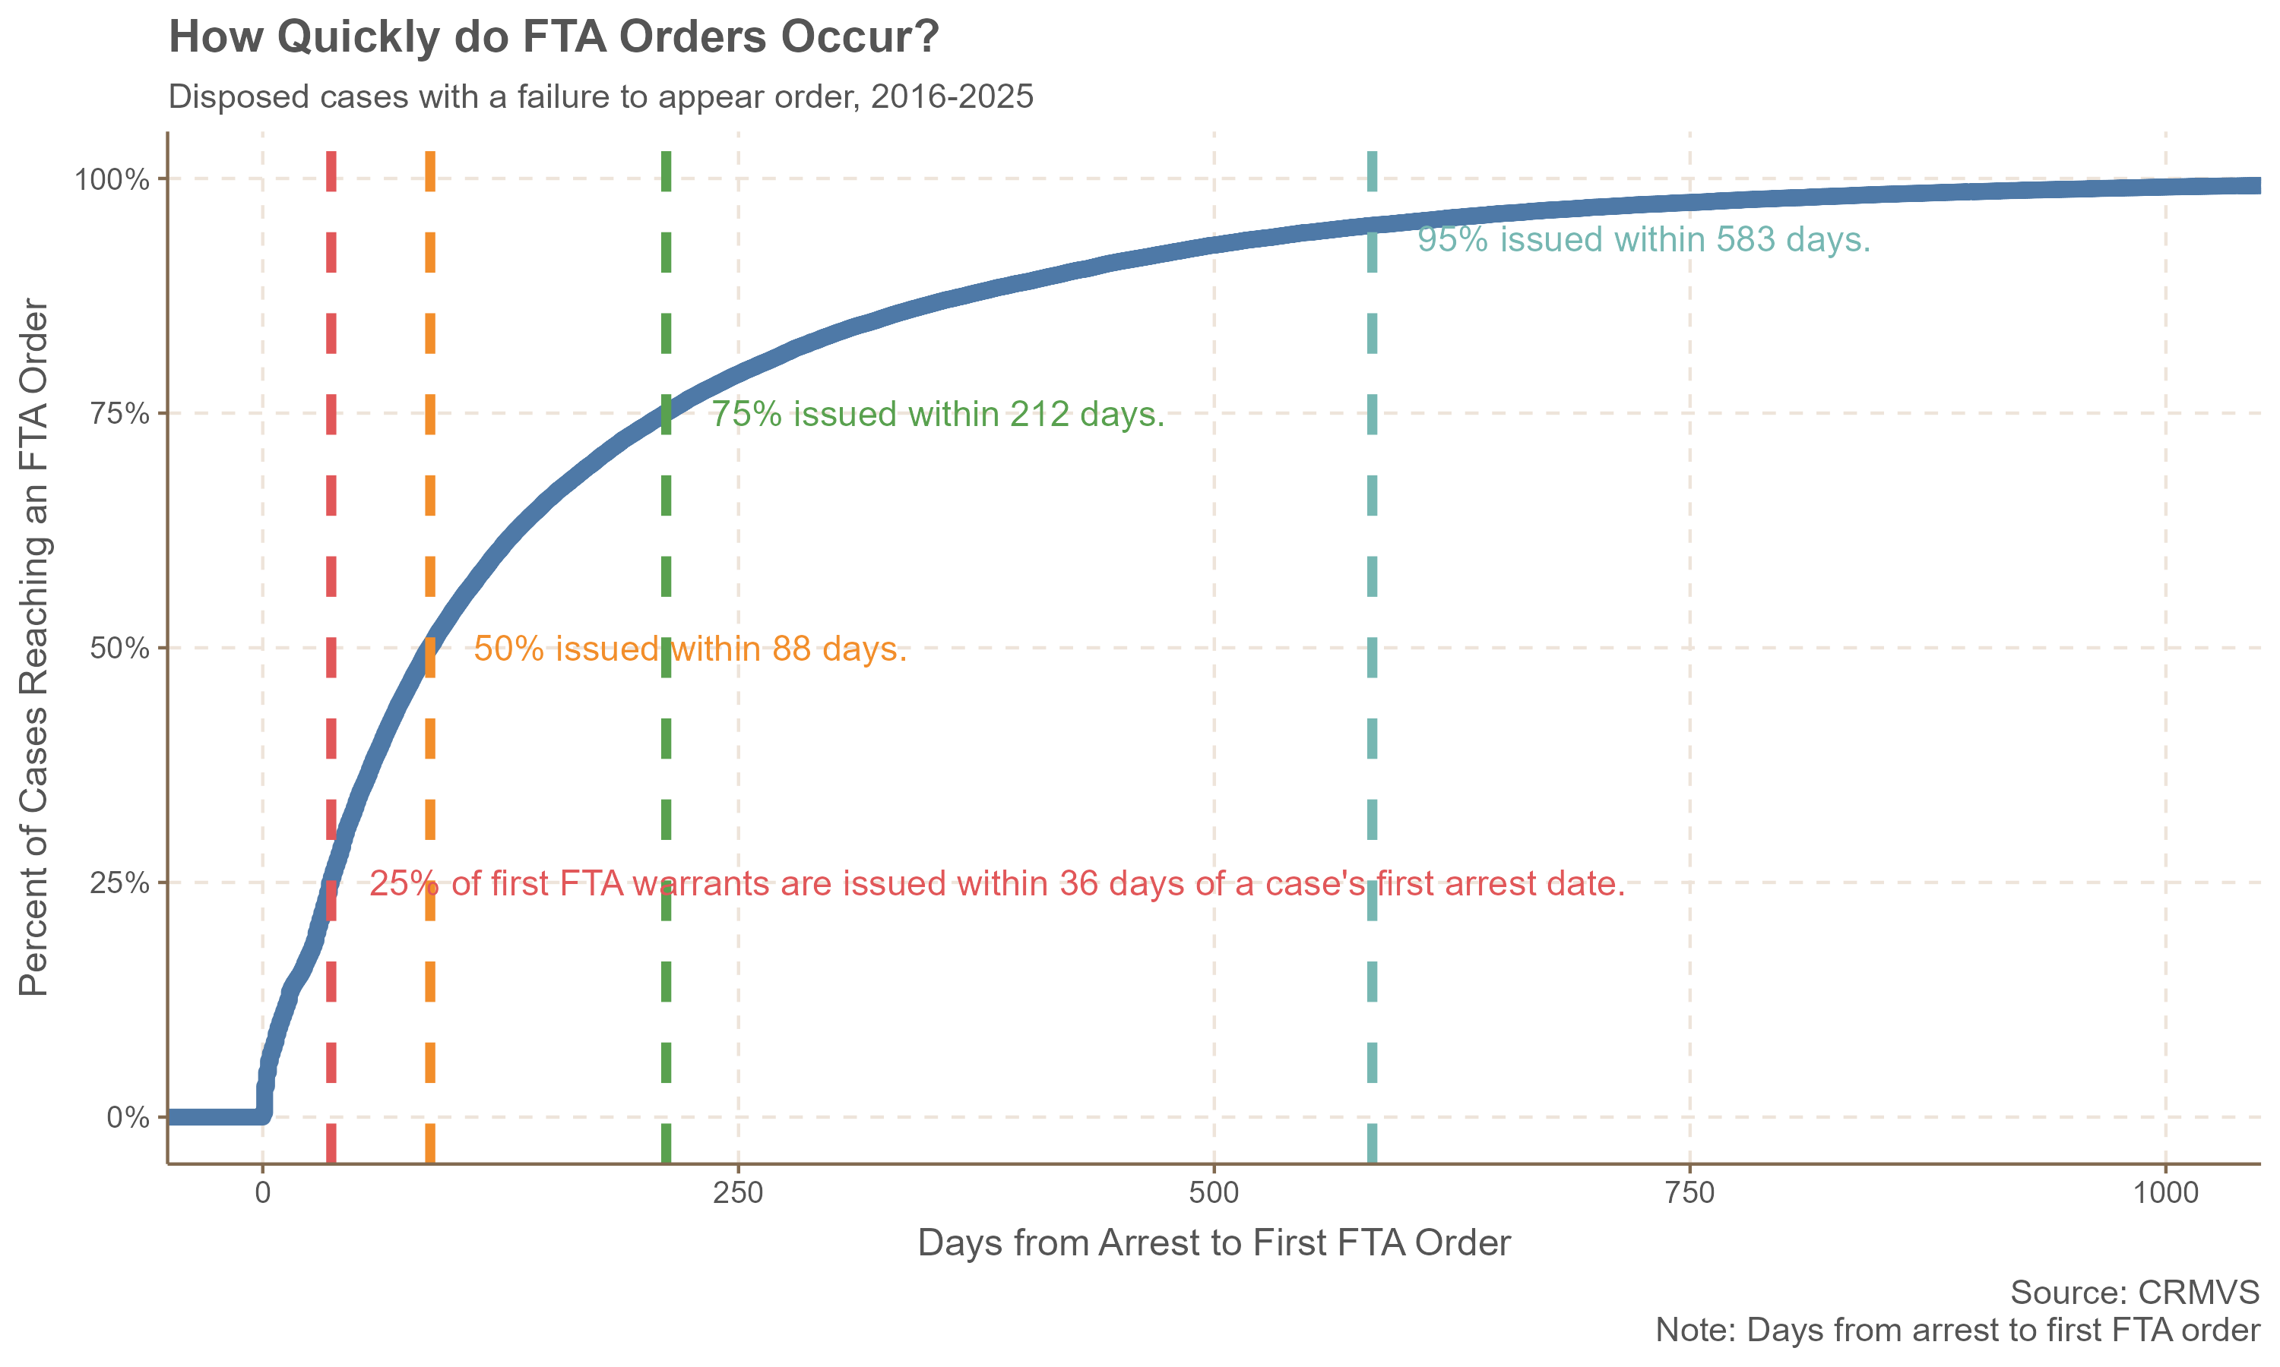

Slide 21
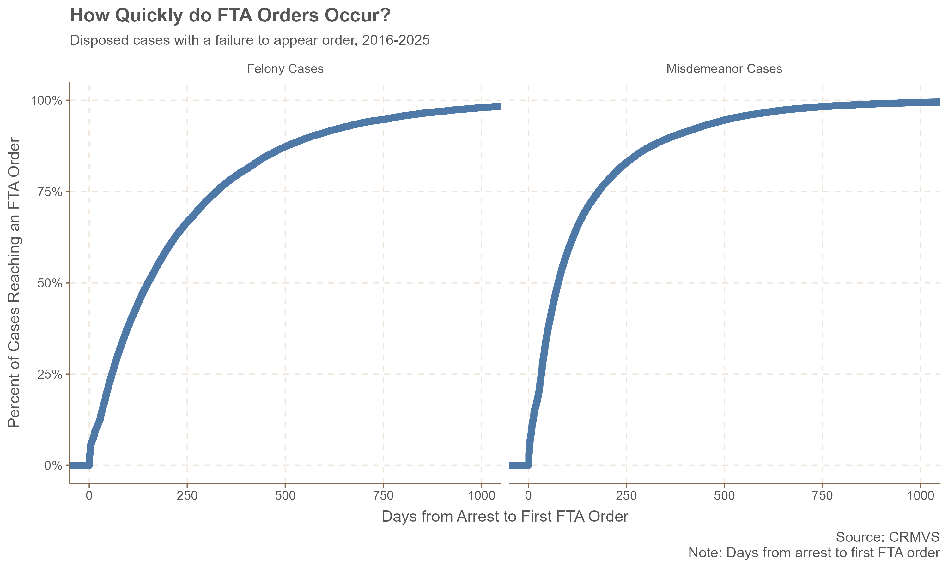
50% of FTA warrants in felony cases are issued within 150 days
50% of FTA warrants in misdemeanor cases are issued within 76 days.

Slide 22
Limitation
A defendant’s history of failure to appear before each case starts is unknown.
Cases involving defendants with multiple prior failures to appear in other cases may be more likely to have warrants issued more quickly (i.e., the 25% of cases where the warrant is issued within 36 days).

Slide 23
Key Takeaways
There are 51,113 active FTA warrants as of February 2026
The majority are non-felony warrants
There is strong variation across judicial districts in the number pending
Certain jurisdictions make up a larger portion of warrants than they do cases, particularly Stamford-Norwalk
Certain jurisdictions make up a much smaller portion of warrants than they do cases, particularly Hartford
57% of warrants are older than five years
There is large variation across judicial districts in the number of these lingering warrants
In recent quarters, the number of warrants issued has increased while the number of warrants served has decreased
The number of warrants vacated in a given quarter varies drastically
Certain JDs tend to vacate warrants at a higher rate than others, potentially suggesting differing state’s attorney practices
The FTA warrant rate is between 15-20% for misdemeanor cases and around 10-14% for felony cases. This rate is sensitive to the inclusion of all cases or only disposed cases.
The FTA charge rate tends to be lower than the FTA warrant rate.
The vast majority of warrants are issued within two years of the case’s original arrest date, but a sizable portion are issued within the first 30 days of a case.

