Slide 1

Pretrial Detention Exploration: Low Level Felonies
Matt Hono, IMRP

Slide 2
Agenda
Case flows
Number of people detained where the primary charge is a Felony D or a Felony E
Number of charges pending among those detained and released
The charges that this population is facing
The length of time detained for

Slide 3
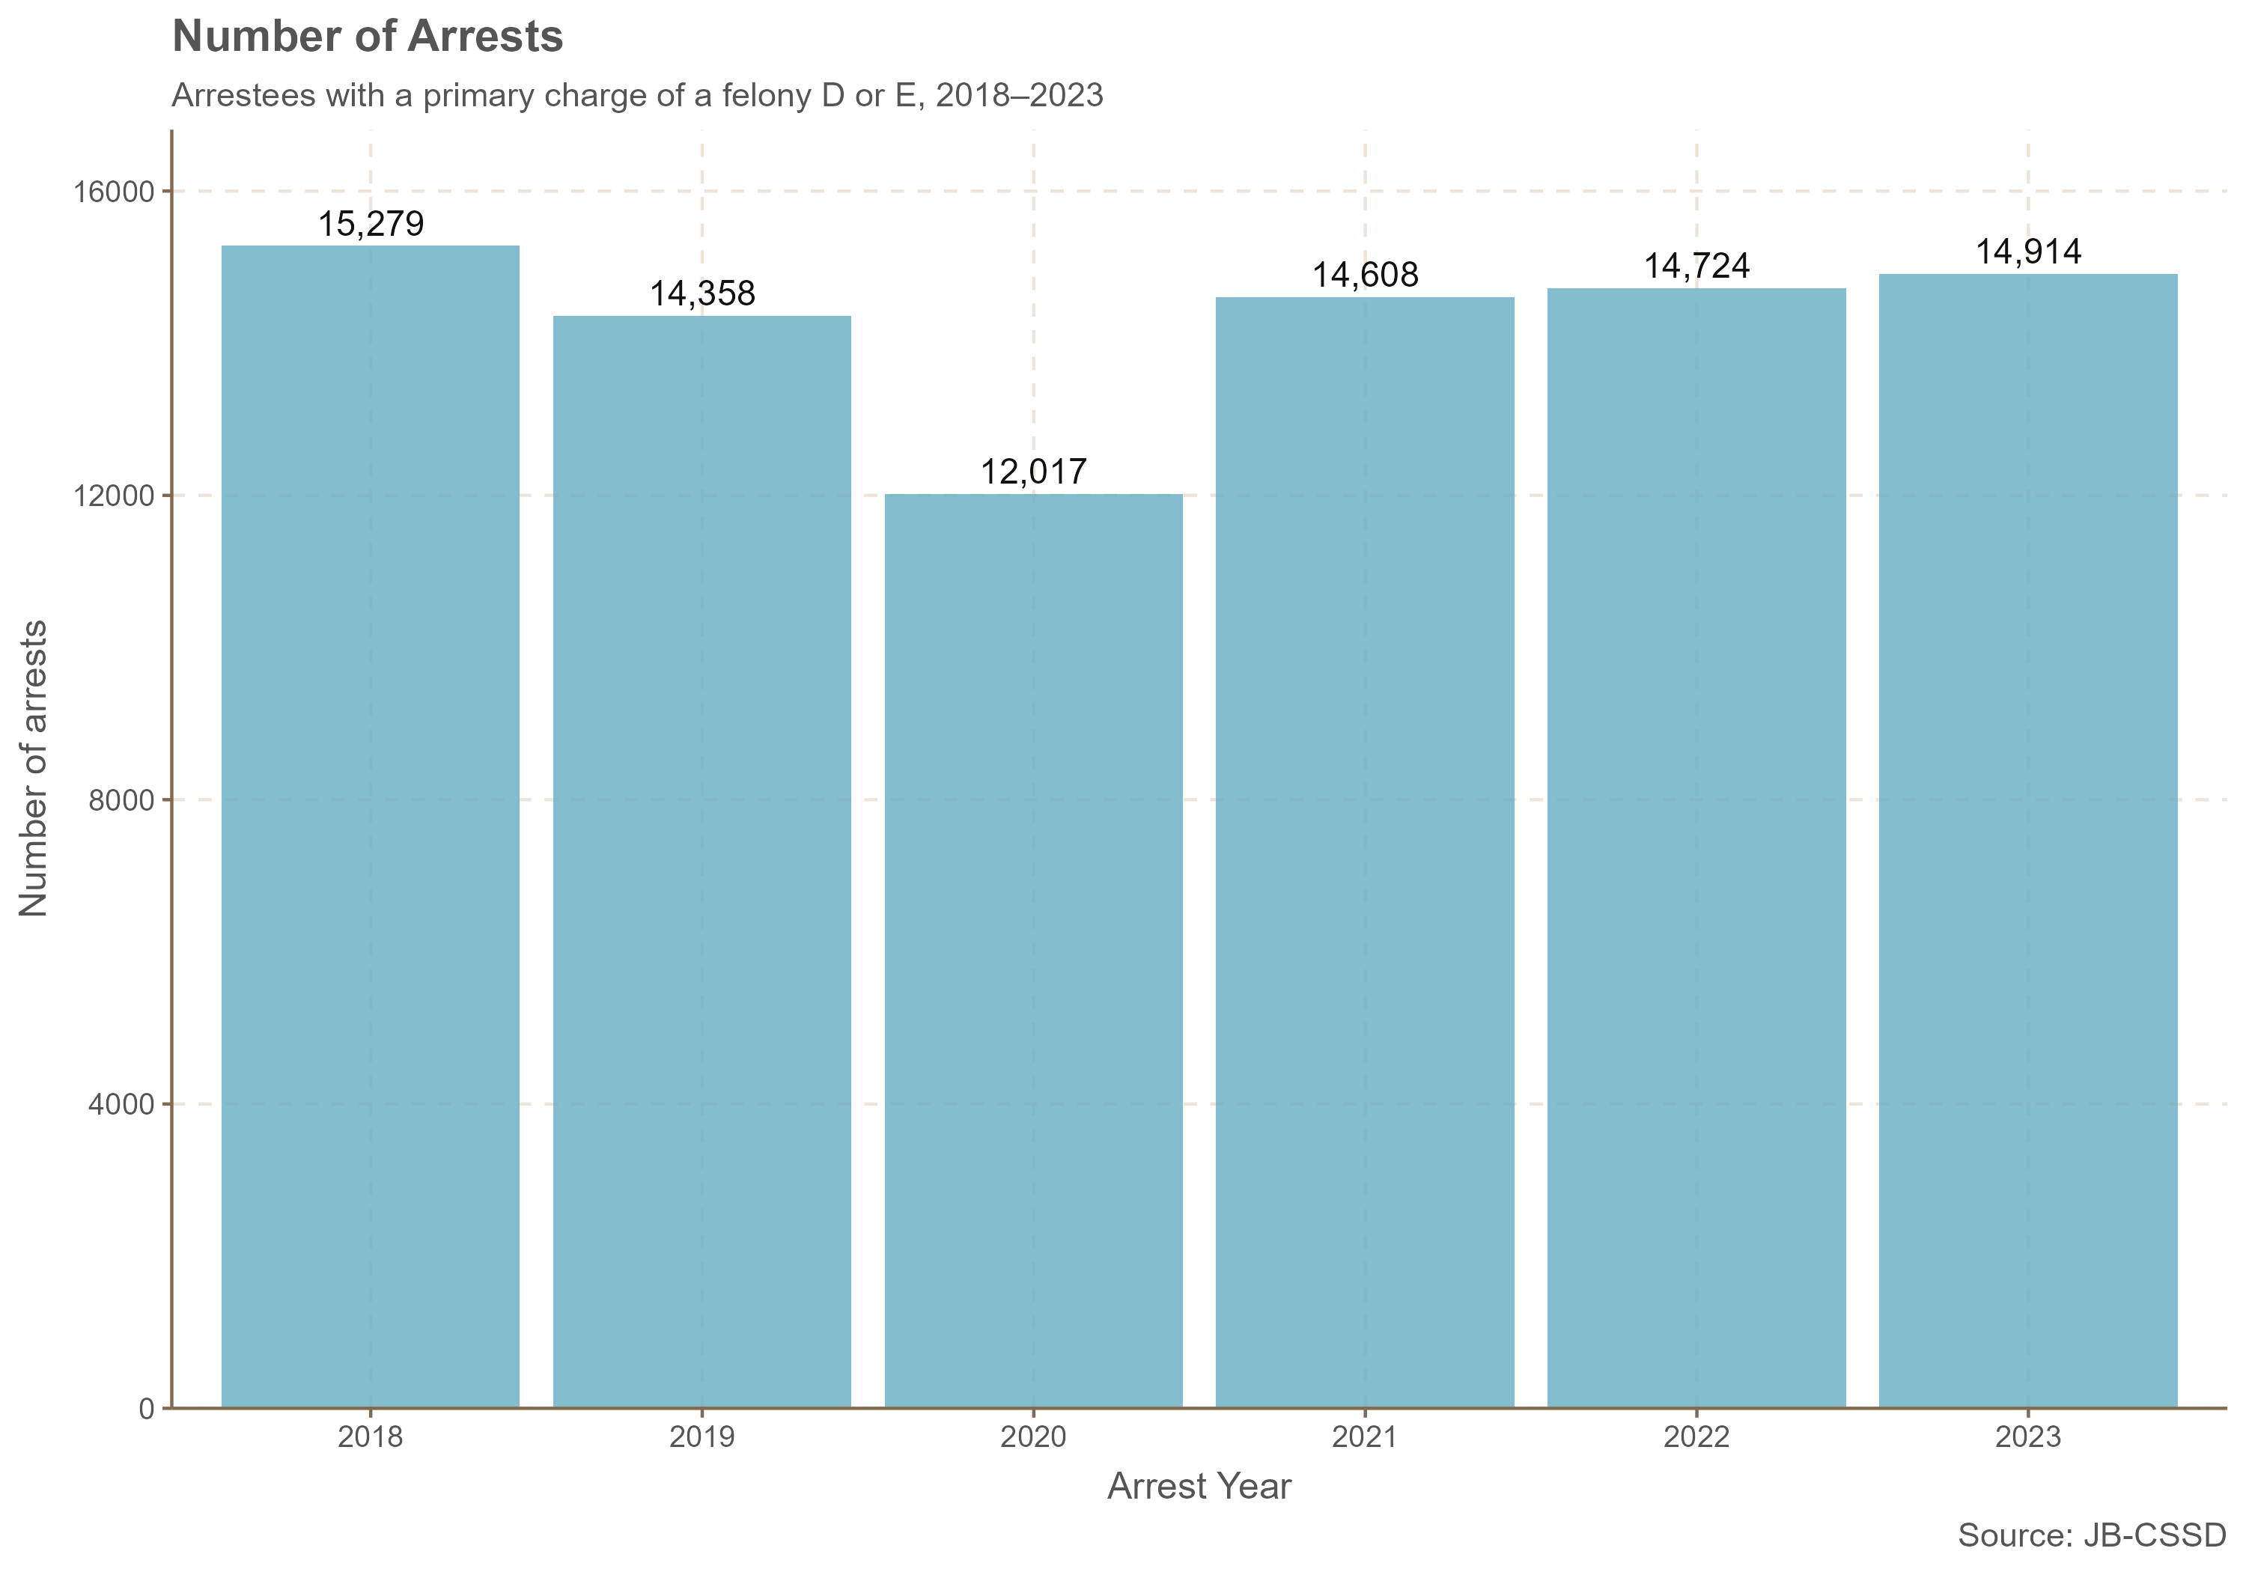
Number of felony D and E arrests

Slide 4
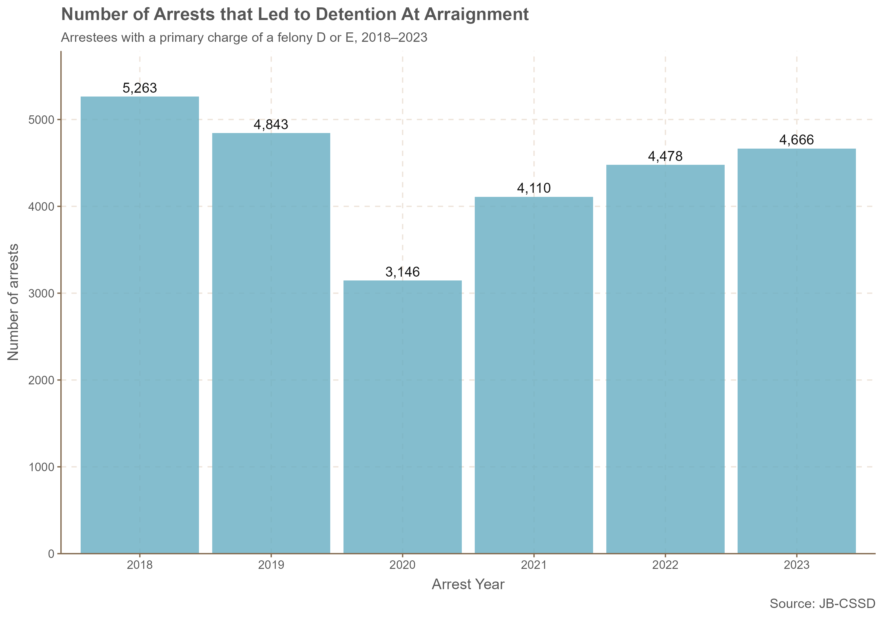
Number of felony D and E arrests that lead to detention

Slide 5
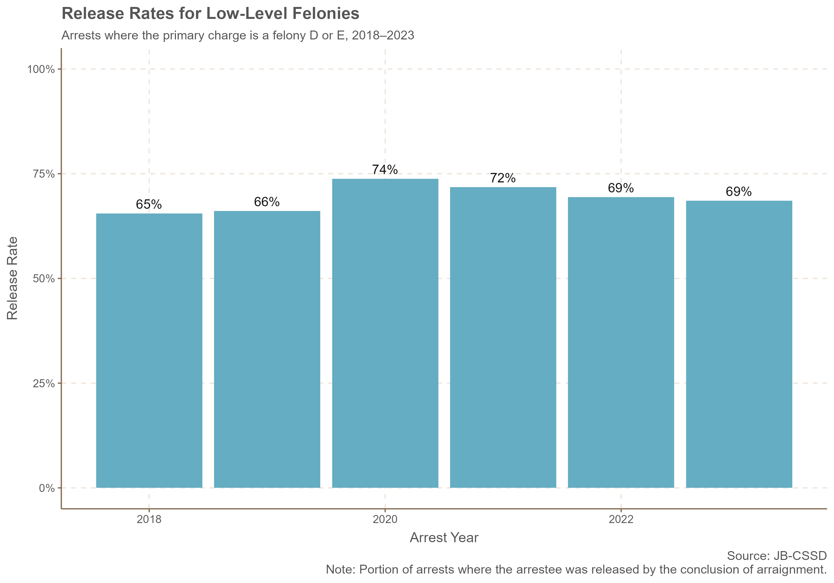
Release rates for low level felonies

Slide 6
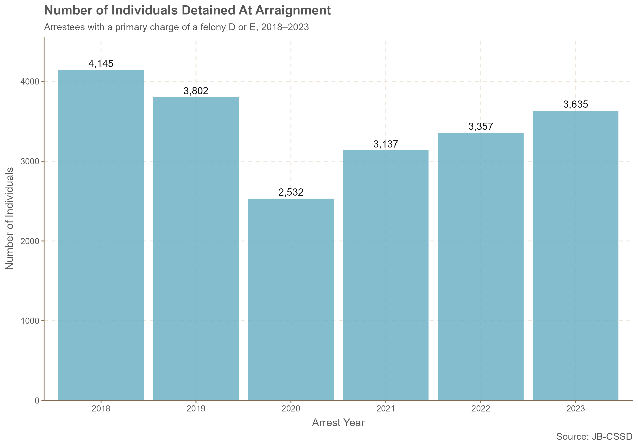
Number of individuals detained

Slide 7
Pending Charges: CSSD Interviewed Clients Where the Top Charge is a Felony D or E
Arraignment Bond Order Outcome | Average number of charges | Percent facing less than 5 charges | Percent facing 5 or more charges
Detained | 9.7 | 33% | 67%
Released | 6.3 | 51% | 49%
Source: JB-CSSD, 2018-2023

Slide 8
Most Common Felony D Charges Among Those Detained, 2018-2023
Arraignment Outcome | Charge_Orig | StatuteType | StatuteClass | Count of Charges
Detained | VIOLATION OF PROTECTIVE ORDER | F | D | 11,363
Detained | BURGLARY 3RD DEG | F | D | 3,867
Detained | LARCENY 3RD DEG | F | D | 2,482
Detained | FAILURE TO APPEAR 1ST DEG | F | D | 2,093
Detained | ASSAULT 2ND DEG | F | D | 1,170
Detained | IDENTITY THEFT - 3RD DEGREE | F | D | 998
Detained | CRIM VIO OF RESTRAINING ORDER | F | D | 815
Detained | VIO STDING CRIM PROTECTIVE ORD | F | D | 799
Detained | STRANGULTN/SUFFOCATE-2ND DEGRE | F | D | 785
Detained | CRIMINAL MISCHIEF 1ST DEG | F | D | 714
Note: Among cases where the highest charge is a Felony D or E AND the arraignment outcome was detained, these are the most common charges.
Source: JB-CSSD

Slide 9
Most Common Felony D Charges Among Those Released, 2018-2023
Arraignment Outcome | Charge_Orig | StatuteType | StatuteClass | Count of Charges
Released | VIOLATION OF PROTECTIVE ORDER | F | D | 23,193
Released | FAILURE TO APPEAR 1ST DEG | F | D | 6,482
Released | LARCENY 3RD DEG | F | D | 5,079
Released | BURGLARY 3RD DEG | F | D | 4,024
Released | ASSAULT 2ND DEG | F | D | 2,908
Released | CRIM VIO OF RESTRAINING ORDER | F | D | 2,582
Released | ILL POSS WEAPON IN MTR VEHICLE | F | D | 2,424
Released | FORGERY 2ND DEG | F | D | 2,179
Released | CRIMINAL MISCHIEF 1ST DEG | F | D | 1,865
Released | IDENTITY THEFT - 3RD DEGREE | F | D | 1,720
Note: Among cases where the highest charge is a Felony D or E AND the arraignment outcome was released, these are the most common charges.
Source: JB-CSSD

Slide 10
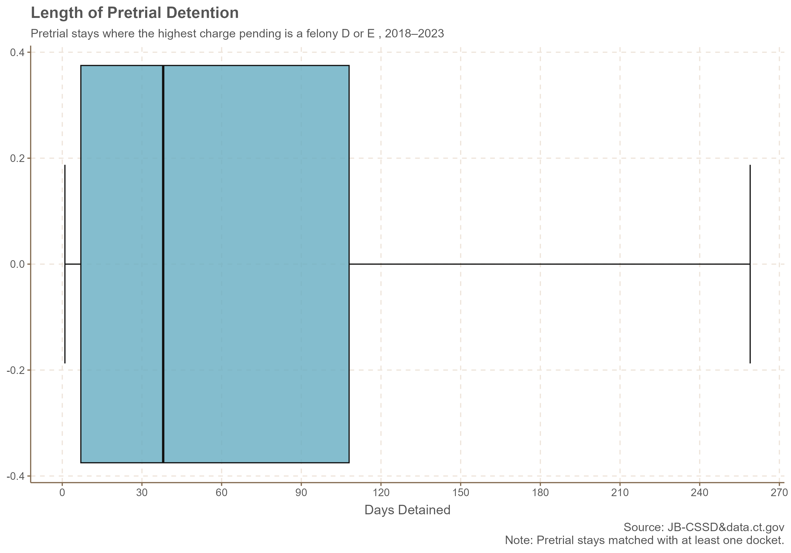
Length of Stay for Low-Level Felonies

