Slide 1

Pretrial Comparative Report Overview
Connecticut Sentencing Commission Steering Committee
August 26, 2026

Slide 2
Presentation Roadmap
Evolution of the Report
Architecture of the Report
Examples of Comparative Discussion
Questions & Guidance
Notes:
This discussion is not necessarily about the substantive differences between the jurisdictions, but instead a presentation of the structure and scope of the report, and as we continue finalizing this report, we’re asking whether this is the right direction and the right product for the Commission to produce.

Slide 3
Evolution of the Report
Alex Tsarkov
  Prior reports
  Judge Cronin’s guidance
  Alex & Judge Cronin departure
Rich Sparaco
  Lessen N.J. focus
  Refine accessibility
  Refine report focus
  Condense content
  Thomas Dowd’s Assistance & development
Notes:
Despite the visual set up, this is not intended to encourage comparison

Slide 4
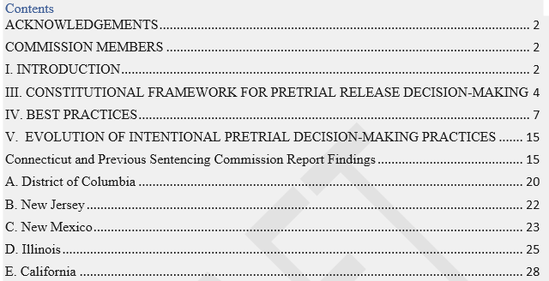
Architecture

Slide 5
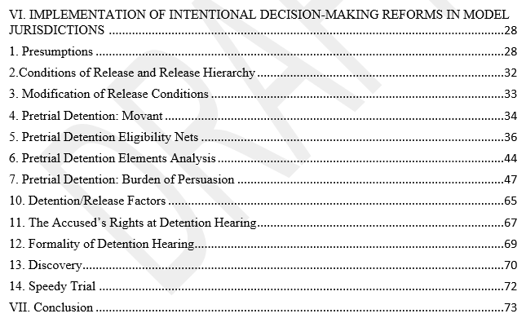
Architecture

Slide 6
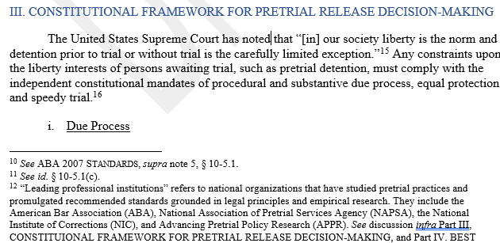
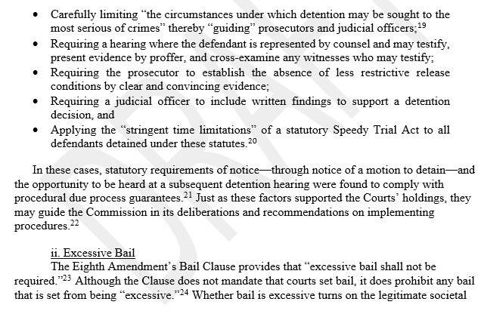
Constitutional Framework
Architecture
Wider discussion of Constitutional development and case law, including:
Eighth Amendment Bail Clause
Stack v. Boyle
  Ruling pretrial bail set higher than reasonably calculated to ensure appearance is excessive
United States v. Salerno
  Permitting preventive detention under the 1984 Bail Reform Act

Slide 7
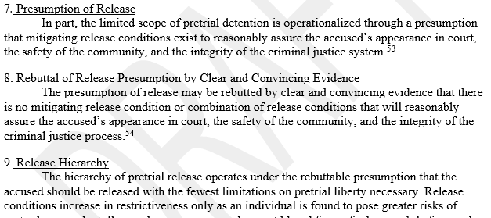
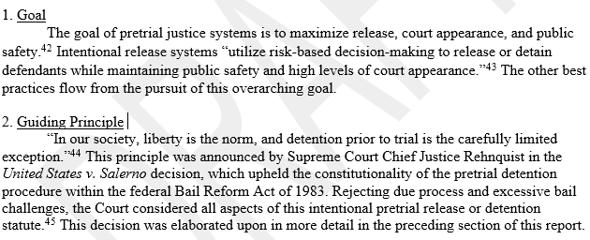
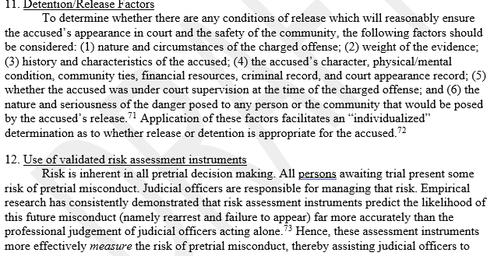
Best Practices
Architecture
A brief overview of the practices recommended by leading professional, research, and policy organizations, including:
American Bar Association
National Association of Pretrial Services Agencies
National Institute of Corrections
Advancing Pretrial Policy & Research
Brief descriptor of those recommendations and practices, designed for quick reference:
Minimizing reliance on secured bond
Detention/release factors
Standard Conditions of Release
Responsibilities of Pretrial Service Agencies

Slide 8
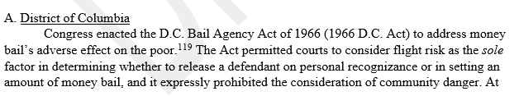
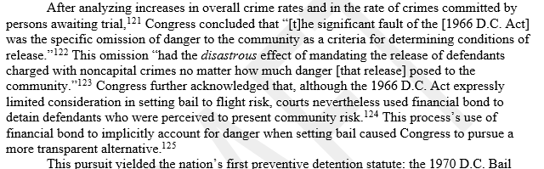
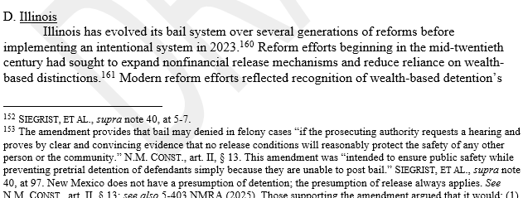
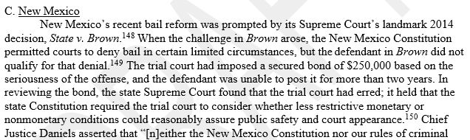
Evolution Across Jurisdictions
Architecture
Retained initially identified “model jurisdictions”:
D.C.
New Jersey
New Mexico
Illinois
Other jurisdictions discussed:
Connecticut
  Ground the reader in practices as a comparative point
California
  Noting recent developments potentially beginning the state’s pretrial reformation
Notes:
Be sure to develop a script emphasizing the importance of D.C., and Edwards as the touch stone for many practices. Touch on unique qualities of Ne Mexico and Illinois; confusion and challenges. These are not necessarily talking about the statutory differences, but instead touch on the challenges of these jurisdictions over the course of implementing reform
Contextualize CT as following the development of these reports.

Slide 9
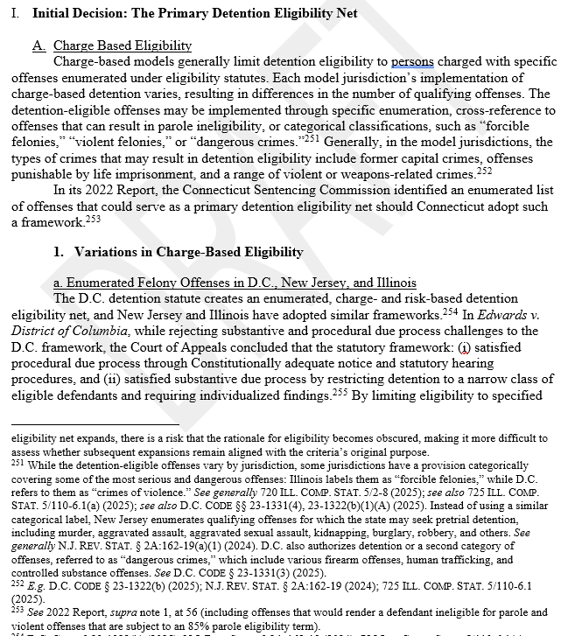
Implementation Section
Architecture
Develops the previous sections for a more in-depth comparison and discussion of procedures and practices.
Builds on the context of the prior passages.
Notes:
Of course, there is some overlap between this section and the prior sections. For example, the Best practice section provided a high level summary of some of the discussion, whereas under the implementation section, those points are elaborated on. And that’s why this section is double the length of the others.
But there’s a dual intent here: while there is elaboration, a lot of this report also acts as a sign post for where you can seek more information about specific practices. For example, publications by each of these states are utilized throughout, so if one wanted to read about how New Jersey responded to Domestic violence concerns, there’s the summary here, but specific detailed information would be available in new Jersey’s recordation of that experience

Slide 10
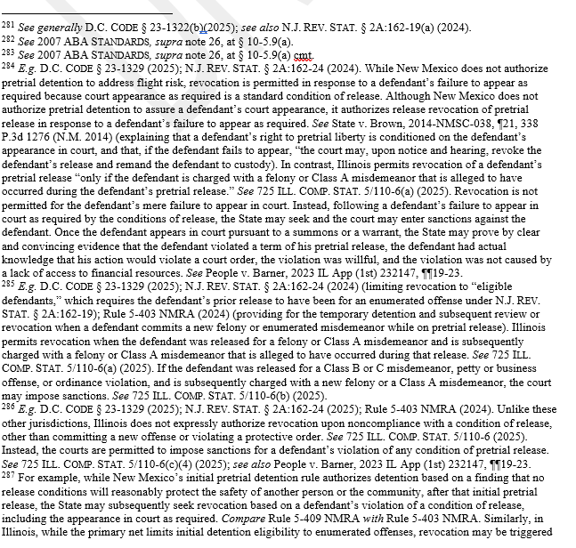
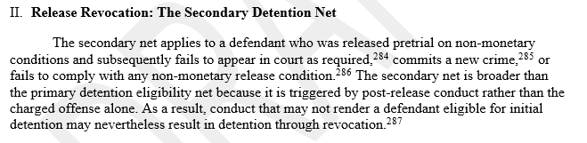
Comparative Discussion Examples
Notes:
In effect, this section is providing the majority of the work, and it’s been the most challenging to filter the language and make more accessible. The comparative work between the jurisdictions and practices is happening here. Because we are developing this report with accessibility and conciseness in mind, some of these sections are deceptively brief. Each of you could read the breadth of this paragraph right now, and that’s most of this particular section. And understand the proposition generally. But the devil is in the details. The differences between, say D.C., and N.J.’s approach to release revocation, as opposed to the approach of New Mexico and Illinois is highlighted with specificity in the footnotes. And that goes back to the design of the report: we have bourn in mind that quick reference utility is incredibly helpful. When juggling multiple obligations, practitioners don’t always have the time to read about how New Jersey frames pretrial detention by authorizing detention, while New Mexico probits it, unless certain circumstances are mett.

Slide 11
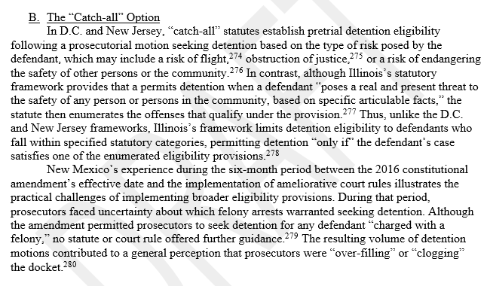
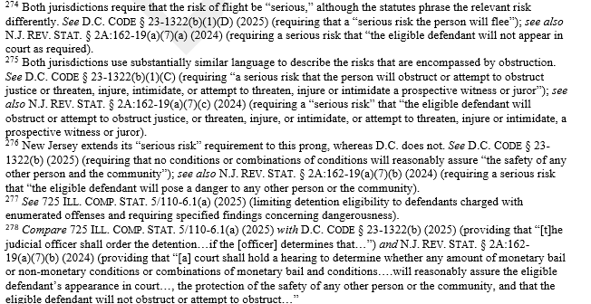
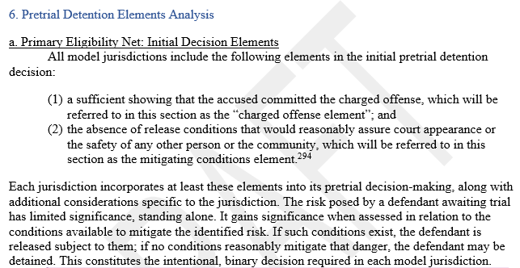
Comparative Discussion Examples
Notes:
Here’s another example of the comparisons between jurisdictions while also referring back to the development and adjustments to the states’ implementation of pretrial reformation. In this case, it’s observing a common practice in several jurisdictions.
(Slide) While the footnote instead is discussing specific statutory differences such as qualifying language in the statutory provision.
The implementation section also has an analytical component that attempts to break down the reasoning and framework of preventive detention into its most basic components and functions. For example, here, the report defines and then discusses basic minimal elements that are common to those models.

Slide 12
Questions and Comments
Notes:
In effect, this section is providing the majority of the work, and it’s been the most challenging to filter the language and make more accessible. The comparative work between the jurisdictions and practices is happening here. Because we are developing this report with accessibility and conciseness in mind, some of these sections are deceptively brief. Each of you could read the breadth of this paragraph right now, and that’s most of this particular section. And understand the proposition generally. But the devil is in the details. The differences between, say D.C., and N.J.’s approach to release revocation, as opposed to the approach of New Mexico and Illinois is highlighted with specificity in the footnotes. And that goes back to the design of the report: we have bourn in mind that quick reference utility is incredibly helpful. When juggling multiple obligations, practitioners don’t always have the time to read about how New Jersey frames pretrial detention by authorizing detention, while New Mexico probits it, unless certain circumstances are mett.

