Slide 1

Pretrial Comparative Report Overview
Connecticut Sentencing Commission
September 9, 2026

Slide 2
Roadmap
Overview of the Preventive Detention Framework
  Preventive Detention, generally
  Presumption of Release
  Salerno “Guiding” Factors
  Mitigating Conditions
  Detention Eligibility Nets
  & Pretrial Services
  Release Revocation
  & Modification of Release Conditions
  Constitutional Framework
Overview of the Comparative Report
  Development of the Report
  Structure of the Report
    Two-half Structure
    the “Model” Jurisdictions
  Source Relied On
  Accessible Presentation
  Statutory Architecture Comparison

Slide 3
Preventive Detention Explained
“…the practice of ordering [a defendant] detained during the pretrial period….these systems require a judicial officer to make informed, intentional, and direct decisions about release and detention, rather than allowing a person’s arrest to be contingent on their access to money.”
-APPR
These decisions can typically concern three broad categories of risks posed by an individual defendant (application varies by jurisdiction):
Safety: “the safety of any other person and the community”
Flight: “appearance of the individual in court”
Obstruction: “a risk that the individual will obstruct or attempt to obstruct justice, or threaten, injure, or intimidate, or attempt to threaten injure, or intimidate a prospective witness or juror”
-D.C. Code § 23-1322(b)
Notes:
hat's intentional. The D.C. pretrial detention framework dates to 1970, was upheld in United States v. Edwards, and subsequently served as an important model for the federal Bail Reform Act. D.C. provides a useful historical and doctrinal reference point for the framework we’re discussing

Slide 4
Presumption of Release
A presumption exists that the individual will be released:
“In our society, liberty is the norm, and detention prior to trial is the carefully limited exception.”
- United States v. Salerno, 481 U.S. 739, 755 (1987).
“A presumption in favor of release on one’s own recognizance” subject to the condition that:
Standard Conditions of release
the individual “appear at all scheduled court appearances and
not engage in criminal activity” during the pending adjudication
- NAPSA Standard 1.3.

Slide 5
Presumption of Release
Although release is presumed,
This presumption of release may be rebutted by evidence that the individual poses “a substantial risk of [one of the three risk categories] warranting a greater level of monitoring or supervision. In these cases, courts may impose conditions of supervision to address these specific risks” that are posted by the individual.
“Conditions must be the least restrictive to address the identified risk.”
Referred to as “mitigating conditions”
least restrictive to address the identified risk
- NAPSA Standard 3.3.
“If, after a hearing…the judicial officer finds by clear and convincing evidence that no condition or combination of conditions will reasonably assure appearance of the person as required, and the safety of any other person and the community, the judicial officer shall order that the person be detained before trial.”
-D.C. Code § 23-1322(b)
Notes:
Point out that the prior slide gave two conditions of release. Note that the conditions are “least restrictive” to effectuate the defendant’s release

Slide 6
Factors Guiding the Court’s Decision
The Supreme Court upheld the 1984 Bail Reform Act, in part, because judicial officers were guided by statutorily enumerated factors, including:
  “nature and the circumstances of the charges,”
  “the weight of the evidence,”
  “the history and characteristics of the putative offender,”
  “and the danger to the community.”
These are the “slide 6 Salerno factors”
- Salerno, 481 U.S. at 751.

Slide 7
Mitigating Conditions
Conditions of release should be “the least restrictive needed to address an individual’s identified and specific risk”
  Ultimately, appropriate conditions depend on the identified risk and range from less to more restrictive.
Leading professional organizations encourage jurisdictions to either eliminate or reduce reliance on financial conditions of release
- NAPSA Standard 4.5(a). cmt. at 86
ROR (subject to standard conditions)
Enhanced reporting / supervision
No-contact orders, geographic restrictions
Travel restrictions, curfews, passport surrenders
Firearm/weapon possession restrictions
Medical, psychological, or psychiatric treatment
Drug/alcohol testing or treatment
Supervision by a designated person or organization
Electronic Location Monitoring
Home detention
Detention
Least
NAPSA Standard 2.2 | ABA Standard 10-5.3 |
APPR Roadmap 4
◯─────●
Most
-D.C. Code § 23-1321(c) | 725 Ill. Comp. Stat. 5/110-10(b)
Notes:
In my actual presentation, I need to state that the organizations a presumption of nonfinancial conditions of release, if the jurisdiction permits financial conditions of release; some equate it with ordering detention.
Include what Connecticut does do here, with restrictiveness

Slide 8
Detention Eligibility & Pretrial Services
Types of Eligibility (varies by jurisdiction)
Enumerated Offenses
  Charge-and risk-based eligibility
    Typically includes “former capital crimes, offenses punishable by life imprisonment, and violence- or weapons-based offenses
Catch-All Eligibility
  Permits detention for qualified instances of the risk of:
    flight, safety, and obstruction
Pretrial Services Agencies
Assist courts to identify and address risks posed by a defendant by:
  Gathering and sharing information about the individual;
  Making recommendations regarding the individual;
  Monitoring compliance with release conditions
  Counseling and referring the individual to support services
  Facilitating and Administering the use of Pretrial Assessment Tools
- D.C. Code § 23-1322(b) | N.J. Rev. Stat. § 2A:162-19 | 725 Ill. Comp. Stat. 5/110-6.1
- D.C. Code § 23-1322(b) | N.J. Rev. Stat. § 2A:162-19
- ABA Standard 10-1.10

Slide 9
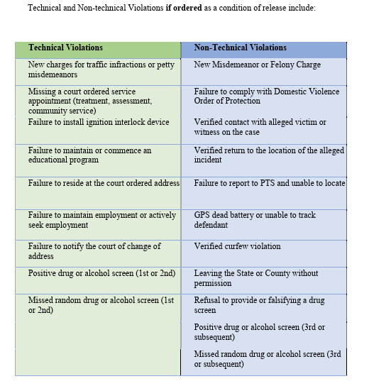
Release Revocation & Modification
Release Revocation
Permits the revocation of an individual’s pretrial release when that a condition of release has been violated
Broader than the initial release/detention decision
Specific implementation varies across jurisdictions
New Mexico example:
Modification
Conditions maybe minimized or increased based on behavior during pretrial release
Compliance is often monitored by Pretrial Services
“Downward” and “Upward” modifications are implemented
These decisions continue to apply the same least-to-most restrictive framework used in the initial pretrial decision.
(specific application varies by jurisdiction)
Whereas the initial release/detention decision is predictive and based on limited information, these decisions are based on the individual’s conduct while on pretrial release.
- ABA Standard 10-5.6
- D.C. Code § § 23-1329(a)-(b) | N.J. Rev. Stat. § 2A:162-24 | 725 Ill. Comp. Stat. 5/110-6 | Rule 5-403(B) NMRA
◯──────────────●
- Admin. Off. Cts., Violation of Conditions of Release 2 (2024)
Least
Most
Notes:
Mention that the individual is being monitored by Pretrial services, or a similar agency, so the type of evidence is different than it would be otherwise.
Use the fact that misdemeanor charges are part of the non-technical violations list, even though they’re not part of the initial detention framework

Slide 10
Constitutional Framework for Preventive Detention
The Supreme Court upheld the Bail Reform Act of 1984 because, under the statute, detention decisions:
were carefully limited to “the most serious of crimes” and “the judicial officer…is guided by statutorily enumerated factors…”
required a hearing where the individual is represented by counsel, could testify, present evidence by proffer, and cross-examine any witnesses who may testify on behalf of the government
required the government to establish the absence of less restrictive release conditions by clear and convincing evidence
required the judicial officer to include written findings supporting the detention decision
were subject to the Speedy Trial Act’s requirements
the most serious of crimes
guided
by statutorily enumerated factors
,
absence of less restrictive release conditions
written findings
- Salerno, 481 U.S. at 747, 751.

Slide 11
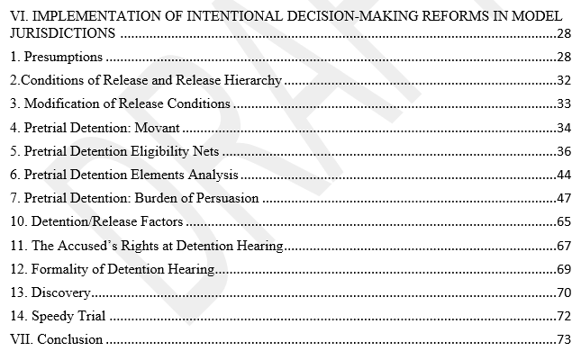
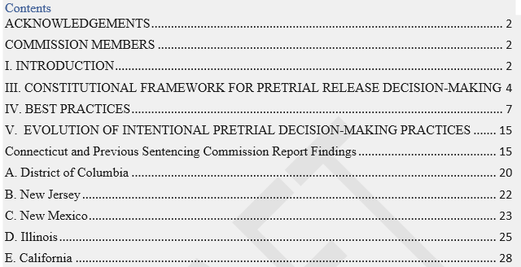
Development of the Comparative Report
Initial Draft by Judge Martin Cronin (retired)
Condense & Refining Report Content
Edits Focused on Accessibility

Slide 12
Sources for Information
Constitutional
  Supreme Court and relevant Circuit Court decisions addressing Constitutional challenges
Best Practices
  Leading Professional, research, and policy organizations, including:
    American Bar Association, National Association of Pretrial Services, National Institute of Corrections, Advancing Pretrial Policy & Research
Reports by the Model Jurisdictions
  Documenting and reporting their experiences while implementing preventive detention practices

Slide 13
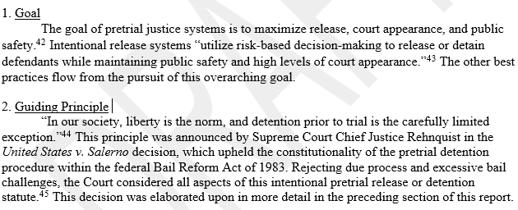
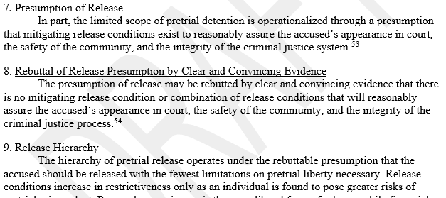
Accessibility Focus
Quick-Reference Structure
  Providing context for conceptual bases to build-on in later report
  Serves to refresh recollection after initial reading

Slide 14
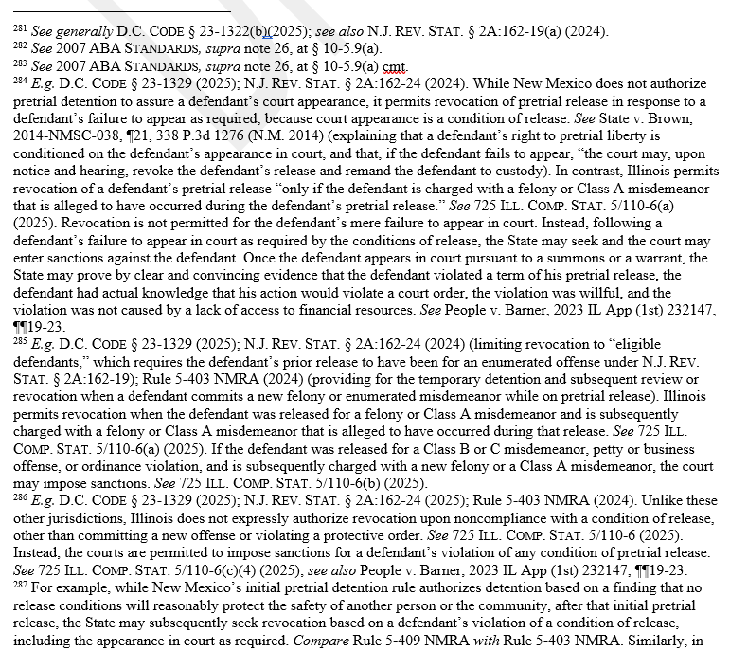
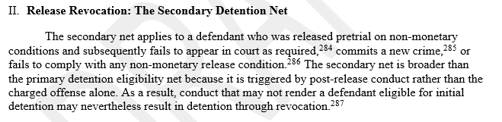
Build on Earlier Accessible Presentation
Evolution Section
  Discussion of Connecticut Pretrial Practices
    Anchor for gauging pretrial practices of model jurisdictions
Implementation Section
  Includes analytical content of general practices
  Includes direct comparisons between the jurisdictions
    Continues accessibility presentation

Slide 15
Consideration of Individualized Information Compared
Jx | Release Decision Being Made | Statutory Language | Auth
D.C | Whether any conditions will assure appearance and safety | “The judicial officer shall hold a hearing to determine whether any condition or combination of conditions…will reasonably assure…” / “The judicial officer shall…, take into account information available concerning” [slide 6 Salerno factors] | D.C. Code §§ 23-1322(b), 1322(e)
NM | Whether any condition or combination of conditions will assure safety/appearance | “the district court shall…determine whether any release condition or combination of conditions in Rule 5-401 NMRA will reasonably protect…” / “In determining the least restrictive conditions of release….the courts shall consider…results of a pretrial risk assessment instrument….In addition, the court may take into account…” [slide 6 Salerno factors] | Rules 5-409(F)(6) NMRA, 401(C)
NJ | Whether any bail/ condition/conditions will reasonably assure appearance, safety, and non-obstruction | “ …the court shall order the pretrial release… when, after considering all the circumstances, the Pretrial Services Program’s risk assessment and recommendations on conditions…, and any information that may be provided…” / “In determining in a pretrial hearing whether no amount of monetary bail, non-monetary conditions or combination of conditions would reasonably assure… the court may take into account information concerning…” [slide 6 Salerno factors] | N.J. Rev. Stat. §§ 2A:162-17(a) 2A:162-20
IL | Which conditions, if any, will reasonably assure appearance and safety | “… the court shall hold a hearing and may deny [release] only if…no condition or combination of conditions…can mitigate [risk of safety or flight]”/ “In determining which conditions of pretrial release, if any, will reasonably ensure the appearance...or safety…, the court shall, on the basis of available information, take into account such matters as…” [slide 6 Salerno factors] | 725 Ill. Comp. Stats. 5/110-5(a), 110-6.1
CT | Which earliest listed condition is sufficient to reasonably assure appearance (and safety, in specified cases) | “a judicial authority…shall…promptly order the release…upon the first of the following conditions…found sufficient:…[1-2. types of PTA, 3-5. types of money bonds] ” / “may…consider the following” [slide 6 Salerno factors] | Conn. Practice Book §§ 38-4(a),38 -4(b)
Notes:
Although the comparison jurisdictions differ in how they integrate individualized information, conditions of release, and detention eligibility, their frameworks permit the release decision to turn on whether conditions can adequately address the identified risks. Connecticut's framework instead principally asks which listed condition is sufficient to permit release.
Mention how CSSB offers services like pretrial services, but the information they collect is treated different to that of PSA in these jurisdictions. Mention that much of the context behind these statutes and how they sit in their jurisdictions is not reflected here.
“The important thing I want to highlight here is that we're not just comparing the factors that judges consider. We're comparing the decision that those factors are being used to make.”
“In these other jurisdictions, the inquiry can ultimately become: are there conditions of release that can adequately address the identified risks? And if the answer is no, the framework can lead to detention.”
“Connecticut's framework is structured differently. It principally asks: which condition of release is sufficient? The statute directs the court to move through a prescribed set of release options and impose the first condition it finds sufficient.”
“So the distinction isn't simply that Connecticut considers different information, or gives judges more or less discretion. The underlying release decision itself is structured differently.”

Slide 16


Consideration of Individualized Information Compared
Distinguishing point | D.C., NM, NJ, IL | CT
1. What is the court ultimately considering? | What conditions/combination of conditions should be imposed to reasonably assure appearance/safety/non-obstruction? | Which statutorily prescribed condition is the first condition sufficient to reasonably assure appearance/safety?
2. How do individualized factors enter that consideration? | The Court uses available information about the defendant and circumstances to tailor conditions to the identified risks. | The court may consider available individualized information in deciding whether the statuary condition before it is sufficient.
Resulting model | “tailoring” | Sequential sufficiency
Notes:
Attempt at simplifying the prior slide

Slide 17
Concluding Thoughts and Questions
Notes:
Make clear that this is not a conclusive, evaluative finding ; “mechanical sequencing” and “tailoring” are short hands I’m using for explanatory purposes in this presentation. Instead, what the report does, is presents the context, the jurisdictional frameworks, and invites the comparison without making it making an evaluative conclusion. Different readers may come to different conclusions based on different insights, and this report wants to inform the conversation.

